Slide 1
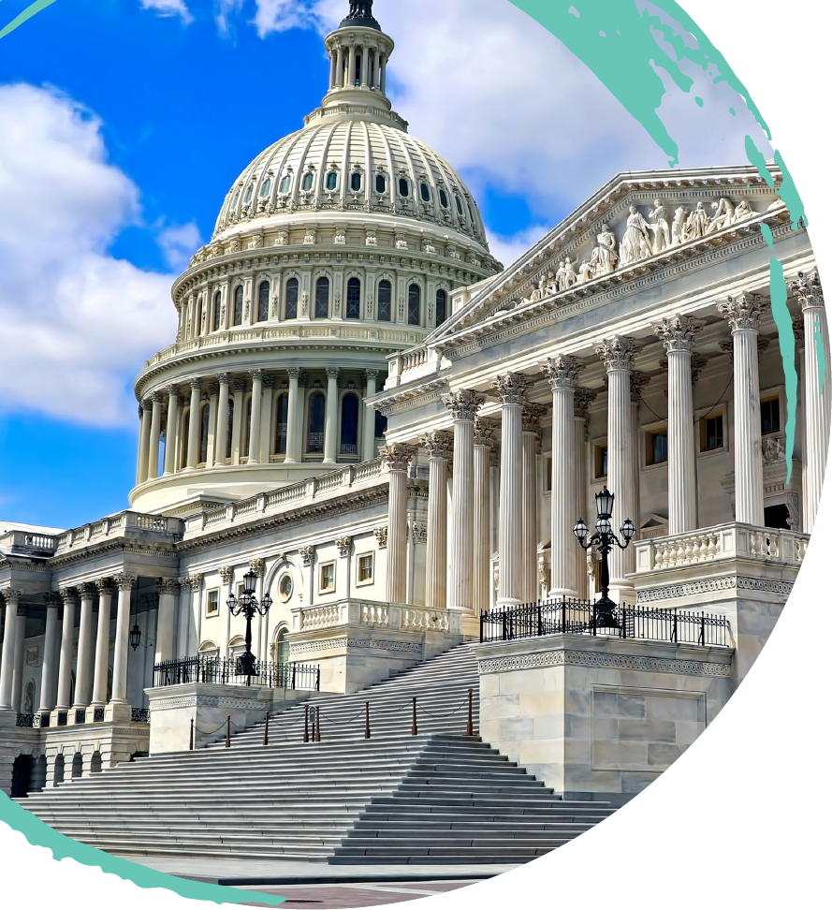

Slide 2
Materiality
Overview
The term “material” is inherently imprecise and vague and requires context:
“How far down from the maximum can you go before something stops being substantial? How far up from the minimum can you go before something stops being minor? Even if you think you know the answer, there is no guarantee that the other party feels the same way and that the obvious alternative is nontrivial, with trivial expressing the obverse.” (Adams)
Even if a contract defines what is material, the court’s analysis will not necessarily stop with such express definitions.

Slide 3
Materiality
Material
“Material” in the context of disclosure or satisfaction of a condition or representation is based on whether the information “changed the mix of the information so it would” cause the buyer to act differently or would “affect the decision of the buyer or investor.” This is the TSC standard.
“Material” is also based upon whether the term is “essential to the transaction” and would be relied upon by a reasonably prudent buyer.
See: TSC, Frontier, Motor City Bagels (applying TSC standard to failure to provide accurate start-up costs), Love of Food (finding no reasonable reliance on misrepresentation of start-up costs), Morris (misrepresentation about yogurt recipe was about a key feature; if material, rebuttable presumption of reliance), Bixby (overstatement about agreements signed essential to the franchise), and Transnet (TSC “total mix test”).
Notes:
overstat

Slide 4
Materiality
In All Material Respects
“In all material respects” normally is used to describe a level of compliance in representations or conditions significant to the parties’ contract, even if a breach of the representation or condition is not severe enough to excuse a counterparty’s performance; it is used to describe compliance in a non-trivial manner or, said another way, excludes trivial non-compliance. (Akorn, Frontier, Channel Systems (using TSC standard)).

Slide 5
Materiality
Material Breach
“Material” as used in the context of completion of conditions for renewal or breach is material if it “will deprive the injured party of the benefit that is justifiably expected under the contract,” “goes to the essence of the contract,” and is defined as “material.”
Maple Shade (found that building unauthorized showroom deprived injured party of benefits of expectations), General Motors (a breach of a reasonable franchise obligation over persistent objections is a material breach), Peterbrooke (breach had to be material under state law going to the essence of the contract; franchisee showed evidence of “immateriality”), Servpro (finding franchisee caused reputational harm and that was material “breach”), Sioux Falls (dictionary definition of “substantial”), S & P Brake (“applied test” touches “fundamental purposes” of contract), McDonalds/IHOP (food safety violations constitute material), and 7-11 (repeated breaches constitute material).

Slide 6
Materiality
Conclusion:
Whether or not the term “material” is used, materiality can be challenged. Drafters should establish that (i) the element considered to be material is foundational to the purpose of the contact; (ii) the lack of relevant information or satisfaction of a condition will change the “mix of information” and “effect any decision of a party reasonably relying upon it”; (iii) the breach or failure of the condition will deprive the non-breaching party of the benefits of the contract and (iv) if applicable, expressly provide that breach of the relevant term is grounds for termination or withholding of approval.
Avoid other uses of terms that can affect determination of “material.”
Consider effect of using the “sole discretion” standard and the impact of the implied covenant of good faith and fair dealing on interpretation.

Slide 7
“Efforts” Standards
OVERVIEW
“Efforts” standards means standards used to reflect a specific level of effort to accomplish a goal or satisfy a condition such as “best efforts,” “reasonable efforts,” “commercially reasonable efforts,” “good faith efforts,” and “reasonable best efforts.”
Although practitioners generally accept the idea of a hierarchy of “efforts” standards in which terms mean specific levels of effort, US caselaw does not support the hierarchy.
Inherently vague, compliance with any “efforts” standard will be a function of context like the term “material.”
Agreeing to an obligation to perform on an unqualified basis still subjects enforcement of provision to challenge; consider effect of “sole discretion” standard and impact of the implied covenant of good faith and fair dealing.

Slide 8
“Efforts” Standards
BEST EFFORTS
Some practitioners believe that best efforts means an obligation to make every possible effort including expending all financial resources to do so; imposing an extraordinary duty to perform.
Most practitioners treat the different levels of reasonableness standards as requiring less effort than best efforts. US Courts have generally defined “best efforts” by good faith, diligence, or reasonableness standards and do not require a party to work against its own interests.
Permanence (extravagant phrase); Trecom (semantics); Alsto (not acting against self interest); Samica (make efforts as reasonable in light of party’s ability and means and the other party’s justifiable expectations – requires diligence); Paccar (asserted best efforts had no meaning; court found diligence and reasonable efforts needed; but also said plaintiff must view the proposed transfer in most favorable light); Maestro (defendant argued best efforts void; good faith and diligence required); Ehringer (best efforts by itself insufficient – must state goal or guideline against which it is measured); and Hermann (goals must be established to enforce best efforts standard).

Slide 9
“Efforts” Standards
COMMERCIALLY REASONABLE EFFORTS
Takiedine (means reasonable under totality of circumstances and exercise of diligence; no change by use of term “commercially”); Russell (had defined commercially reasonable efforts; and allegations did not support breach); Akorn (take all reasonable steps to maintain operations in ordinary course); Gifford/Castle (standard is based on what reasonable commercial businesses would do).
Conclusions
When using “efforts” standards, drafters should do the following: expressly define the phrase or provide the specific conditions to be met that would satisfy the intended standard.
Best efforts likely does not mean more than reasonable efforts if reasonable efforts is defined or subject to conditions. Commercially reasonable efforts is not meaningfully distinguishable from reasonable efforts. In each case, it is advisable to include conditions of good faith and diligence in the provision requiring reasonable efforts.

Slide 10
Not to Be Unreasonably Withheld
Overview
The phrase “not to be unreasonably withheld” is another oft-invoked term without clear definition or interpretation.
It is clear that this phrase will be interpreted in light of compliance with any expressly delineated conditions.
Burger King / Ashland Equities (failure to consent was reasonable because franchisee failed to meet express conditions).
Similarly, the presence of additional phrases such as “sole discretion” tends to leave room for very little to be deemed unreasonable.
H & H Restaurants, LLC (language also provided for “sole judgment”).

Slide 11
Not to Be Unreasonably Withheld
Overview cont’d
Franchisor’s course of dealing may also play a role in what is deemed to be unreasonable.
De Walshe (it was not unreasonable for franchisor to refuse to consent to transfer where the potential buyer was not proficient in English, based on the fact that franchisor required all franchisees to be proficient in English)
Consent may only be unreasonable if sought
H-D Michigan, LLC / Quality Oil Inc. (consent could not be deemed to have been unreasonably withheld because the attempted assignee never sought that consent)

Slide 12
Not to Be Unreasonably Withheld
Conclusions
Similar to the use of phrases like “best efforts,” drafters should take care to construct the language around the phrase “not to be unreasonably withheld” so that its meaning in the context of the relevant contract is clear. For instance, it would be advisable to provide specific criteria to be met before any approval/consent will be granted. Alternatively, if the intent is to make the scope of “reasonably withheld” very broad, language that provides discretion can be included.

Slide 13
“Reasonable Business Judgment” Provisions
“Reasonable Business Judgment (as defined herein) applies in all circumstances involving or requiring [Franchisor’s] approval or consent . . . Reasonable Business Judgment means that [Franchisor’s] determinations or choices will prevail, even if other alternatives are also reasonable or arguably preferable, if [Franchisor] intends to benefit or is acting in a way that could benefit the . . . System. . . .”

Slide 14
Does this provision ….
…insulate the franchisor from liability so long as it can show that it has exercised some level
of reasonable judgment in making its decision?
…create a presumption of reasonableness in favor of the franchisor?
…displace the implied covenant of good faith and fair dealing?
… add anything to the franchise agreement?

Slide 15
Armstrong v. Curves International, Inc.
Plaintiff alleged scores of contract breaches, including, for example, a claim that the franchisor had offered no support to franchisees. The court held:
The reasonable business judgment provision did not apply to mandatory requirements – e.g., an operations manual.
“Second, simply because the ‘Reasonable Business Judgment’ clause provides Curves latitude in making certain decisions does not foreclose altogether the possibility that it could be held liable for its decisions.”
“A reasonable jury could very well conclude that these actions were unreasonable and not intended to benefit the Curves system.”
The decisions do not discuss, or refer to, any presumptions.

Slide 16
Does a Reasonable Business Judgment Provision Oust the Implied Covenant of Good Faith?
Many states include subjective “bad faith” as an element of a good faith claim; “bad faith” is outside the scope of business judgment.
Some states, and the UCC, look to whether the conduct was commercially reasonable.
Express waivers?

Slide 17
Conclusions on Reasonable Business Judgment
Doubtful if they add a layer of protection.
They may add a layer of duties – and liability.
Probably don’t oust good faith.

Slide 18
Waivers of Individual Liability of Franchisor Officers and Agents
“Franchisee hereby waives the right to bring any action against any individual owner, officer, director or employee of the Franchisor entity or of the Franchisor’s Affiliates.”
“No past, present or future director, officers, employee, incorporator, member, partner stockholder, subsidiary, controlling party, or representative of ours will have any liability for any obligation we have relating to or arising from this Agreement, or any claim against us based on the transaction contemplated by this agreement.”

Slide 19
Waivers of Liability of Franchisor Officers and Agents
No precedents in franchising; look to real estate development law.
Individual liability waivers enforced.
Must be a third-party beneficiary of the agreement.
Waivers won’t be construed to protect against one’s own wrongdoing.
May be limited to negligence.

Slide 20
Arbitration
“All disputes and claims arising out of or relating to this agreement, or to the breach thereof, or to any of our standards or operating procedures, or other obligation of either yours or ours, or to the breach thereof, or any aspect of the relationship between you and us, including our officers, directors, agents and employees, must be resolved by arbitration.”

Slide 21
Arbitration
Franchisee commences arbitration against corporate franchisor and individual development officer for false financial performance representations.
Or
Franchisee sues the individual in court.
What result?

Slide 22
Arbitration
In order to compel arbitration, there must be a “written agreement for arbitration” between the parties. 9 USC § 4.
Bases for compelling arbitration against non-signatories: (1) incorporation by reference; (2) assumption of liability; (3) agency; (4) veil-piercing or alter ego; (5) estoppel; or (6) third-party beneficiary.

Slide 23
Conclusions on Officer and Agent Liability
Waivers of liability, while effective, may not be as broad as they say on their face, and may not add anything to the agreement.
Attempting to require claims against franchisor officers to be arbitrated without having them sign creates uncertainty. This might be mitigated by provisions expressly stating that officers and agents are third-party beneficiaries of the agreement.

Slide 24
Choice of Law
“This Agreement shall . . . be interpreted and construed under the laws of the state in which the Franchisor’s principal place of business is located.”

Slide 25
What do you want the choice-of-law provision to cover?
Construction and interpretation of the agreement.
The relationship, disputes, claims?
Persons covered.
State-specific laws, including franchise laws.

Slide 26
Limitations
Some states have borrowing statutes.
Some states view limitations as “procedural” and apply their own law.

Slide 27
Conclusions on Choice of Law
Be sure of your intent and express it clearly.
Make sure you understand wrinkles in limitations.

Slide 28
Damages
Risk Management
Allocation of each Party’s Risk
Predictability of Potential Exposure
Evaluating Adequacy of Consideration

Slide 29
Damage Limitations
To be enforceable, damage limitations must be specifically agreed upon in writing

Slide 30
Defining “Damages”
Absent a defined term in the agreement, courts will interpret the term “damages” broadly

Slide 31
Limitation of Damages
FRANCHISOR AND FRANCHISEE HEREBY WAIVE TO THE FULLEST EXTENT PERMITTED BY LAW ANY RIGHT TO OR CLAIM OF ANY CONSEQUENTIAL, PUNITIVE, OR EXEMPLARY DAMAGES AGAINST THE OTHER, AND AGREE THAT IN THE EVENT OF A DISPUTE BETWEEN THEM EACH SHALL BE LIMITED TO THE RECOVERY OF ANY ACTUAL DAMAGES SUSTAINED BY IT.

Slide 32
Limitation of Damages
FRANCHISEE HEREBY WAIVES TO THE FULLEST EXTENT PERMITTED BY LAW, ANY RIGHT TO OR CLAIM FOR ANY PUNITIVE, EXEMPLARY, INCIDENTAL, INDIRECT, SPECIAL OR CONSEQUENTIAL DAMAGES (INCLUDING, WITHOUT LIMITATION, LOST PROFITS) AGAINST FRANCHISOR ARISING OUT OF ANY CAUSE WHATSOEVER (WHETHER SUCH CAUSE BE BASED IN CONTRACT, NEGLIGENCE, STRICT LIABILITY, OTHER TORT OR OTHERWISE) AND AGREES THAT IN THE EVENT OF A DISPUTE, THAT FRANCHISEE’S RECOVERY IS LIMITED TO ACTUAL DAMAGES.

Slide 33
What Does “Actual Damages” Actually Mean
Actual Damages can be broader than the parties anticipated
Court will apply state law when determining the scope of “actual damages” if the term is not defined
Bonanza Rest. Co. v. Wink – court interpreted actual damages to also include consequential damages

Slide 34
Direct Damages
Damages awarded to compensate for actual losses
Inherent in the breach
The usual result of the breaching parties’ wrongful act
Foreseeable and contemplated by the parties.
Under certain circumstances, loss of profits can be “actual” damages

Slide 35
Indirect Damages
Exemplary
Punitive
Consequential
Incidental
Special
Loss of Profits

Slide 36
Exemplary/ Punitive Damages
Damages awarded which are beyond the actual damages incurred
Punitive in nature
Used to “punish” the bad actor for acts such as fraud, gross negligence and deliberate acts
Awarded when the parties’ behavior is found to be especially harmful and egregious
Intended to dissuade

Slide 37
Special / Consequential Damages
Secondary or derivative losses incurred by the damaged party.
Such damages must have been foreseeable and a highly probable consequence of the breach
Must be traceable to and the result of the wrongful act

Slide 38
Incidental Damages
Damages incurred by the damaged party to avoid or mitigate the losses created by the breach.

Slide 39
Lost Profits
Can be classified as both direct and indirect damages.
Generally viewed as consequential damages
Direct
Can be deemed direct damages if the damaged party bargained for such profits (Bonanza Rest. Co. v. Wink)
Flows naturally and necessarily from the wrongful act

Slide 40
Are Limitation of Damage Provisions Worth the Fight?
Impact of State Laws
Little FTC Acts/ Disclosure Laws
Franchise Relationship Laws
Other State laws

Slide 41
Are Limitation of Damage Provisions Worth the Fight?
Judicial Enforcement
Public Policy Concerns
Unconscionability

Slide 42
Limitation of Damages – Best Practices
Clearly defined terms
Clearly indicate if waiver applies to both direct and consequential lost profits
Waiver language should be conspicuous
Capitalized letters
Bold print
Severability Provision
Mutuality

Slide 43
Severability Clause
IF ANY TERM OF THIS AGREEMENT IS FOUND OR DETERMINED TO BE UNCONSCIONABLE OR UNENFORCEABLE FOR ANY REASON, THE FOREGOING PROVISIONS OF WAIVER BY AGREEMENT OF PUNITIVE, EXEMPLARY, INCIDENTAL, INDIRECT, SPECIAL, CONSEQUENTIAL OR OTHER SIMILAR DAMAGES (INCLUDING, WITHOUT LIMITATION, LOSS OF PROFITS) SHALL CONTINUE IN FULL FORCE AND EFFECT.

Slide 44
Lost Profits Example
FRANCHISEE HEREBY WAIVES TO THE FULLEST EXTENT PERMITTED BY LAW, ANY RIGHT TO OR CLAIM FOR ANY PUNITIVE, EXEMPLARY, INCIDENTAL, INDIRECT, SPECIAL OR CONSEQUENTIAL DAMAGES (INCLUDING, WITHOUT LIMITATION, LOST PROFITS) AGAINST FRANCHISOR ARISING OUT OF ANY CAUSE WHATSOEVER (WHETHER SUCH CAUSE BE BASED IN CONTRACT, NEGLIGENCE, STRICT LIABILITY, OTHER TORT OR OTHERWISE) AND AGREES THAT IN THE EVENT OF A DISPUTE, THAT FRANCHISEE’S RECOVERY IS LIMITED TO DIRECT DAMAGES (EXCLUDING DIRECT LOST PROFITS).

