Slide 1












April 13, 2022
HOW TO MAKE YOUR BRAND LOOK
ATTRACTIVE TO PRIVATE EQUITY
SPONSORED BY:

Slide 2


Webinar Sponsor
As the authority in franchise funding, Benetrends has been funding America’s most popular brands for 40 years. Their innovative and comprehensive suite of funding solutions not only helps franchisees successfully launch their dreams, but also helps catapult growth of franchise systems.
INNOVATIVE AND FAST FUNDING SOLUTIONS FOR FRANCHISEES = FASTER GROWTH FOR FRANCHISORS.
Headquarters Lansdale, PA United States

Slide 3




Today’s Speakers
RYAN ZINK, CEO & CO-FOUNDER
FRANCHISE FASTLANE
ERIC SCHECHTERMAN, CDO
BENETRENDS FINANCIAL

Slide 5







Slide 6


How to Make Your Brand Look Attractive to Private Equity
What is Private Equity???
Professionally managed pools of capital focused on investing in private companies
Consist of pension funds, endowments, high net worth individuals or other entities seeking to invest through this asset class.
Long-term driven…Reoccurring Revenue

Slide 7


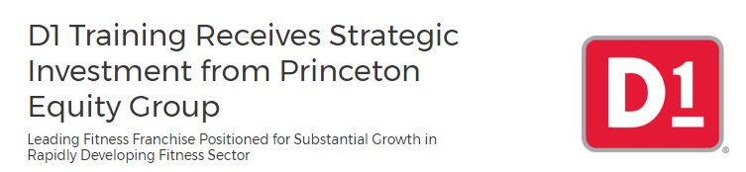
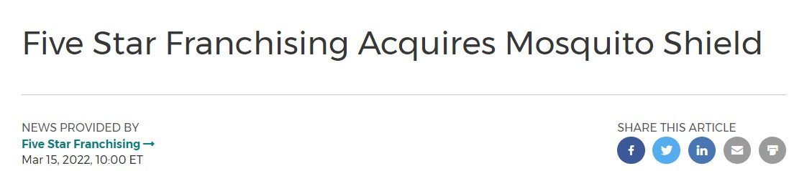
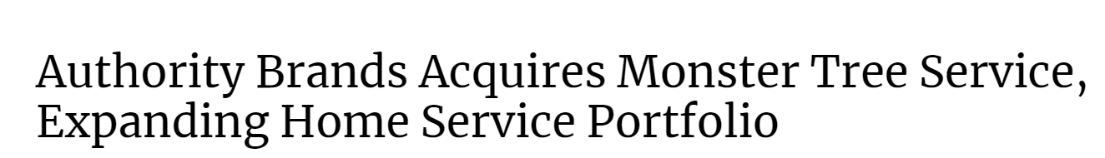
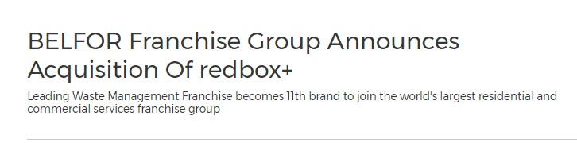
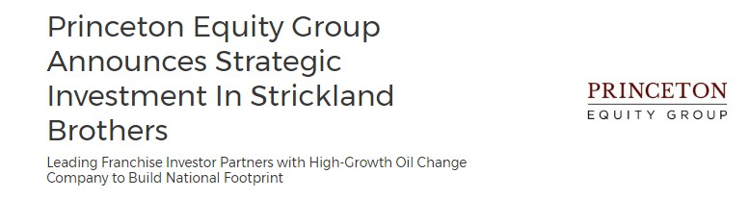

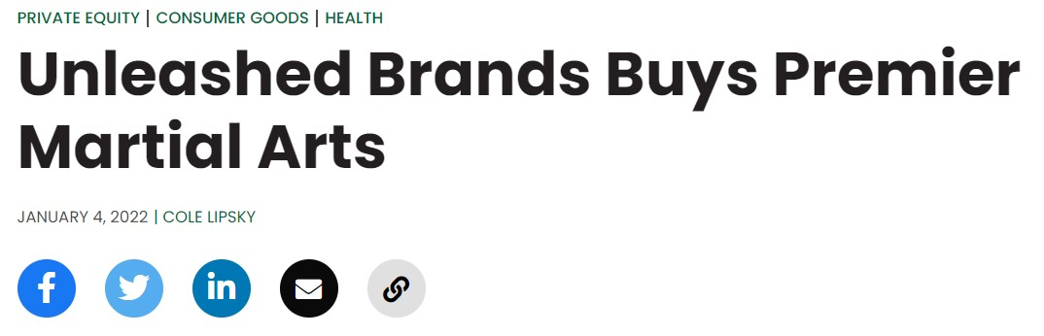
How to Make Your Brand Look Attractive to Private Equity
Why have FastLane brands have had so much success selling to private equity over the years?

Slide 8

How to Make Your Brand Look Attractive to Private Equity
What are they looking for…
Royalties compared to franchise fees Management Team
Position in the market Structure and systems Growth and funding Vendor relationships

Slide 9

How to Make Your Brand Look Attractive to Private Equity
What can/should a brand do???
What can a franchise do NOW?
What should a franchise look to do over time? What costs time? What costs money?
What is easiest to implement? What is the most challenging?

Slide 10











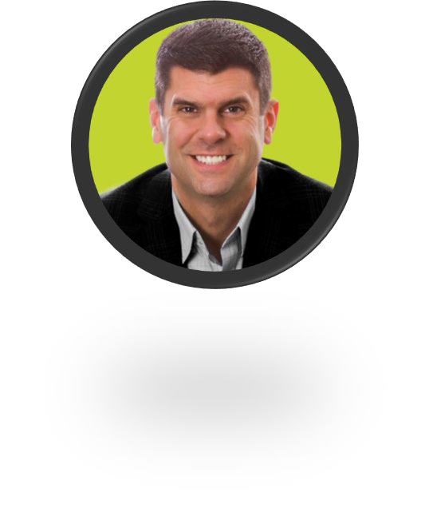



HOW TO MAKE YOUR BRAND LOOK
ATTRACTIVE TO PRIVATE EQUITY
April 13, 2022
RYAN ZINK
FRANCHISE FASTLANE RZINK@FRANCHISEFASTLANE.COM
ERIC SCHECHTERMAN BENETRENDS FINANCIAL ERIC@BENETRENDS.COM
SPONSORED BY:

Slide 11

THANK YOU FOR ATTENDING
SPONSORED BY:

