Slide 1




Royalty Transaction:
A Unique Liquidity & Monetization Strategy for Franchise Founders
IFA WEBINAR SERIES
February 21, 2023
SPONSORED BY:

Slide 2
Webinar Sponsor
Sean Morrison, President and CEO
sean@diversifiedroyaltycorp.com
Greg Gutmanis, CFO and VP Acquisitions
greg@diversifiedroyaltycorp.com

Slide 3
Speakers
Sean Morrison, CEO Diversified Royalty Corp (“DIV”)
Greg Gutmanis, CFO and VP Acquisitions DIV

Slide 4
Options for Founders of Profitable Franchisors
Status Quo
Debt Recapitalization
Private Equity / Sale
Royalty Transaction

Slide 5
Introduction
Diversified Royalty Corp (“DIV”) believes the franchisor business model is a superior business model
Franchisors with proven store level economics, scale, profitability and with the potential to double their store count over time are cash flow machines – the operational leverage of the franchisor model, at scale, is awesome
In the early 2000’s, the management team of DIV was working with several of North America’s best franchisors and invented a unique royalty transaction that generates a meaningful upfront liquidity event while selling no equity – providing the owners of these great businesses¹ a far superior alternative to selling to private equity
¹ A&W Food Services, The Keg Steakhouse and Boston Pizza

Slide 6
Why a Royalty Deal?
It takes a big effort and often a long period of time to build a Franchisor to a point where it has achieved scale and becomes highly profitable
Many entrepreneurs (owners) want to take some money off the table when their Franchisor becomes profitable
Once a Franchisor achieves scale, the equity risk phase (while building to scale) is over – DIV believes owners of high-quality franchisors should retain 100% equity ownership and reap the economic rewards of continuing to scale the business
DIV’s unique trademark and royalty transaction structure provides owners of high quality Franchisors with the liquidity of a private equity deal, while retaining 100% control and the economic upside of continued new store growth
Furthermore, the all-important relationship between the Franchisor and franchisees is unaffected, unlike a change of control private equity deal

Slide 7



Franchisor Attributes for a Royalty Transaction
Franchisor – stable annuity-like revenue streams
Robust store level economics
Strong new store growth prospects
Profitable – $4+M of EBITDA
History of positive SSSG
Amongst the market leaders in its category
Long operating history
Experienced management team
The royalty transaction is primarily targeted at individually-owned franchisor businesses that are seeking a liquidity event and don’t want to sell out to private equity

Slide 8
How a Royalty Transaction Works
Diversified Royalty Corp.
Purchase Trademarks/IP
Franchisor Co
DIV purchases¹ the worldwide trademarks and IP for ~9-10x TTM EBITDA
Cash
Step 1
Diversified Royalty Corp.
Royalty
Franchisor Co
DIV licenses the North American trademarks and IP in exchange for a royalty equal to approximately TTM EBITDA – the royalty would fluctuate based on SSSG or at a fixed rate
License Trademarks/IP
The owners of Franchisor Co:
realize a material liquidity event
retain 100% equity ownership
¹ taxed as a capital gain

Slide 9
How a Royalty Transaction Works
Franchisor Co
Each year, as Franchisor Co opens new stores/markets, its EBITDA should increase
Diversified Royalty Corp.
Incremental Royalty
Franchisor Co
DIV will purchase¹ incremental EBITDA² generated by Franchisor Co at ~9x multiple
Step 2
Cash
Since the owners of Franchisor Co own 100% of the equity, they are able to realize the benefit of monetizing increased profitability from continued new location expansion and operating leverage
¹ taxed as a capital gain ² subject to a royalty coverage test

Slide 10
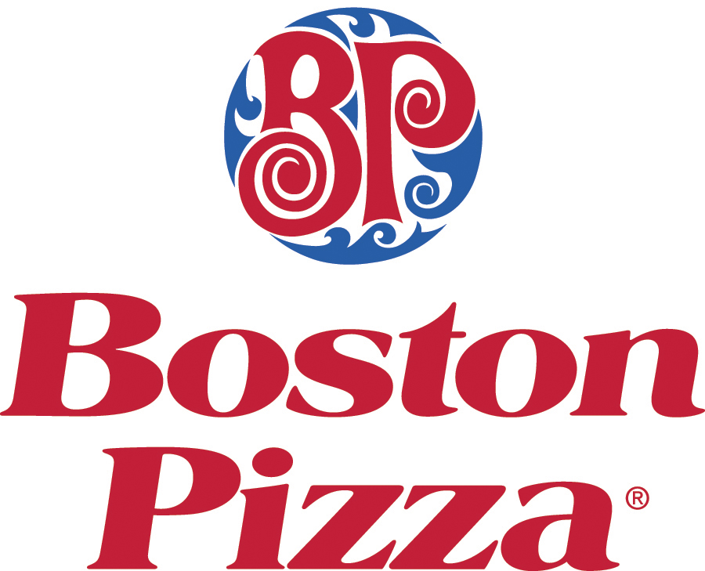
Case Study – Boston Pizza
While the initial royalty transaction creates a meaningful liquidity event, the cumulative proceeds from the sale of incremental royalties over time should dwarf the initial liquidity event – Boston Pizza provides a perfect case study
Casual dining restaurant chain with 150 locations and ~$10M of EBITDA
In 2002, completed a royalty transaction and realized a $98M liquidity event
From 2002 to 2022, Boston Pizza opened 270 additional stores and realized incremental proceeds of over $400M
The owners of Boston Pizza have received total proceeds of over $500M and they still own 100% of the equity!!

Slide 11

First US Royalty Transaction – Stratus
Stratus Building Solutions (“Stratus”) is a franchise business operating in 65 markets, generating ~$150M system sales and profitable – the outlook for Stratus is strong with continued double digit SSSG and opening up an additional 85 markets
The Stratus owners were seeking a liquidity event, but with such strong growth prospects were reticent to sell controlling ownership to private equity – there was simply too much upside
The Stratus owners were introduced to Diversified Royalty Corp and their unique royalty transaction at the IFA Convention in San Diego in 2022
DIV and Stratus announced the first US franchisor royalty transaction on November 14, 2022

Slide 12
First US Royalty Transaction – Stratus
A royalty transaction met all of the Stratus owners’ objectives:
  Meaningful liquidity event
  Maintain control of the business
  Meaningful economic participation in the continued growth prospects of the business
  No change in relationships with its franchisees
The owners of Stratus believe they can replicate the success Boston Pizza had with the royalty transaction

Slide 13
Founder Alternatives
Status Quo
  Pro – retain 100% control
  Con – no liquidity event
Debt recapitalization
  Pro – retain 100% control
  Con – modest liquidity – must pay back
Private Equity / Sale
  Pro – significant liquidity event
  Con – loss of control, investors run the show
  Con – might not align with the founder’s goals
Royalty Transaction
  Pro – significant liquidity event
  Pro – 100% ownership retained
  Pro – participate in value of new store growth
  Pro – manage timing of liquidity schedule

Slide 14
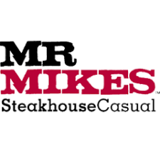




Diversified Royalty Corp
DIV is acquiring a portfolio of trademarks and collecting royalties from high quality multi-location and franchisor businesses
DIV is a ~$600M business generating ~$57M of royalty revenue from seven royalty partners
DIV believes the royalty transaction with Stratus (the first US royalty transaction) combined with the royalty model being proven in the Canadian market over the past 20 years will be a game changer for US franchisors
DIV is actively looking to partner with owners of great franchisor businesses

Slide 15
Summary
Owners of great franchisor businesses in the US have been programmed to think their only source of meaningful liquidity is to sell to private equity
Private equity has earned out-sized returns over the past 20 years buying the equity of great franchisor businesses
DIV believes the franchisor business model is superior and owners of great franchisors shouldn’t have to sell their equity if they want a large liquidity event and continue running their business
DIV’s unique royalty transaction provides owners of great franchisors with the liquidity of a PE deal without selling any equity !!

Slide 16
Questions

Slide 17
Thank You For Attending

