Slide 1



Funding Fireside Chat: Year in review and what to expect in ‘22
SPONSORED BY
Tuesday, February 15, 2022; 1:00pm - 1:30pm
May 26, 2021

Slide 2

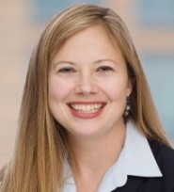
Today’s Presenters
Eric Schechterman, Chief Development Officer
Benetrends Financial
Edith Wiseman, President
FranData

Slide 3

Today’s Topics
• What’s trending
• What are the banks looking for?
• Strategies for emerging brands vs. established brands
• SBA and non-SBA funding strategies
• Perception vs. reality

Slide 4

UPDATE
ON SBA

Slide 5
SBA 7A LOAN VOLUME

Slide 6
SBA 7A FRANCHISE LOAN VOLUME

Slide 7




SBA Lending
Update on the Current Environment
It is not as bad as some are making it BUT it will never be like 2017-2019 again…this is NORMAL
It is not as complicated as you think…it is about balance between the business and the borrower
Liquidity, liquidity, liquidity (Post closing liquidity !!! ). This is very important when working on multi-unit deals.
Avoid the common hurdles: waiting too long - get pre-qualified - collateral - employment status impact - not being open to other options – leaving it to the candidate

Slide 8
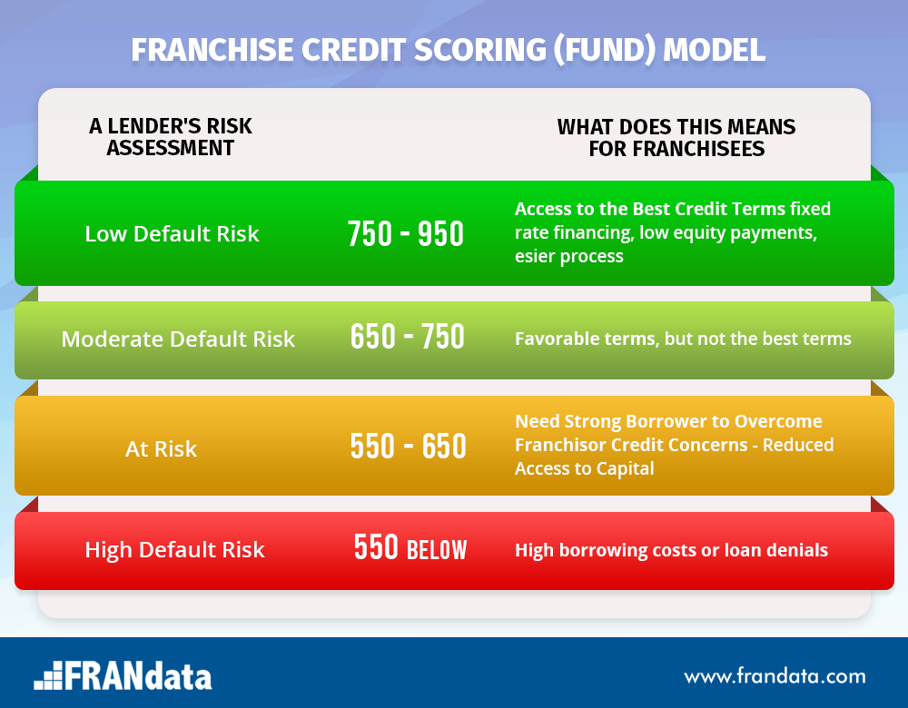
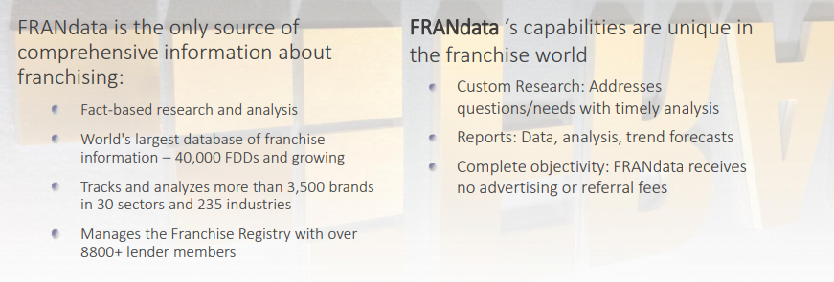
Strategies to support funding
Fund Score
Franchise Registry

Slide 9
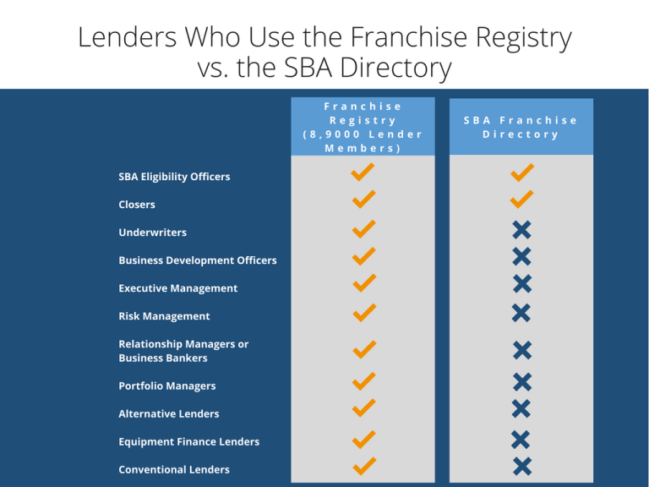
DIFFERENCE BETWEEN SBA DIRECTORY & FRANCHISE REGISTRY
The SBA Directory helps lenders check if a brand CAN obtain SBA financing, while the Franchise Registry is utilized by lenders to see if brands SHOULD obtain financing.
We use the umbrella term “lenders” but, in reality, a loan does not pass through just one set of hands – the potential borrower needs to be identified and developed into a loan opportunity that needs to be analyzed, verified and approved/denied by different people in a lending organization. A portfolio team needs to determine if another loan to the same franchise system can be made again

Slide 10

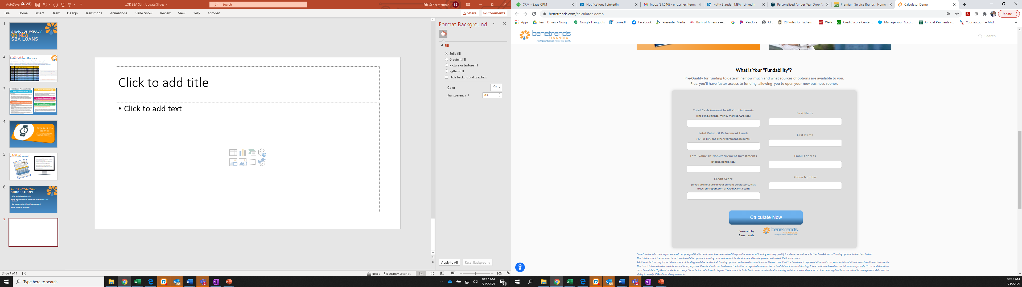
Strategies to support funding
Establish Funding Partnerships
  Identify lenders/banks that already have shown an appetite for your concept or like concepts
  Create a prequalification process for your development team and tools for your websites
  Work to create a templated business plan that will appeal to lenders and make it easier on your candidates
  Having up to date data on your brand and the industry space (FranData reports)
  Training and support for your teams and coordinated updates so the sales process doesn’t stall

Slide 11
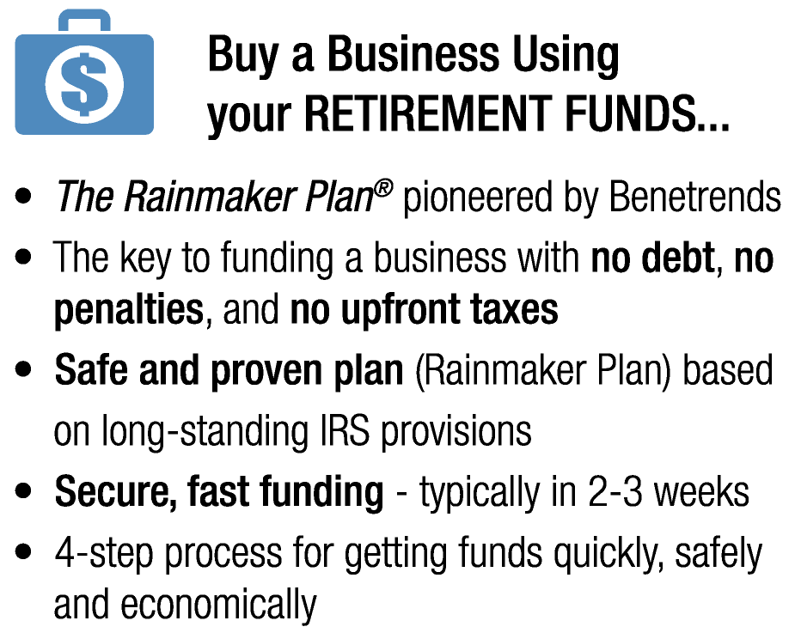
DON’T FORGET
SBA IS NOT THE ONLY WAY

Slide 12

THANK YOU FOR JOINING!
Eric Schechterman, Chief Development Officer
Benetrends Financial
eric@benetrends.com
Edith Wiseman, President
FranData
ewiseman@frandata.com

