Slide 1


How Call Tracking
Powers Higher Revenue for Franchisors
January 11, 2022

Slide 2

Agenda
Why Calls Matter to Franchisors
Conversation Intelligence 101
Meeting the Challenge
Q&A

Slide 3
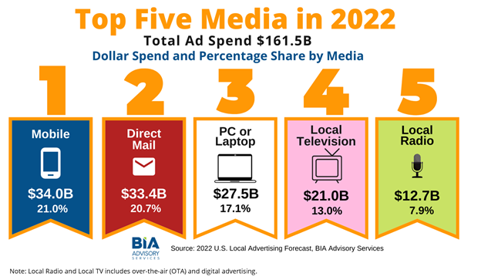
Local Ad Spend on the Rise
Overall local U.S. advertising market is expected to reach $161.5 billion
10.1 percent YoY growth
Increased pressure on franchise marketing teams to allocate budget to what drives the most conversions

Slide 4
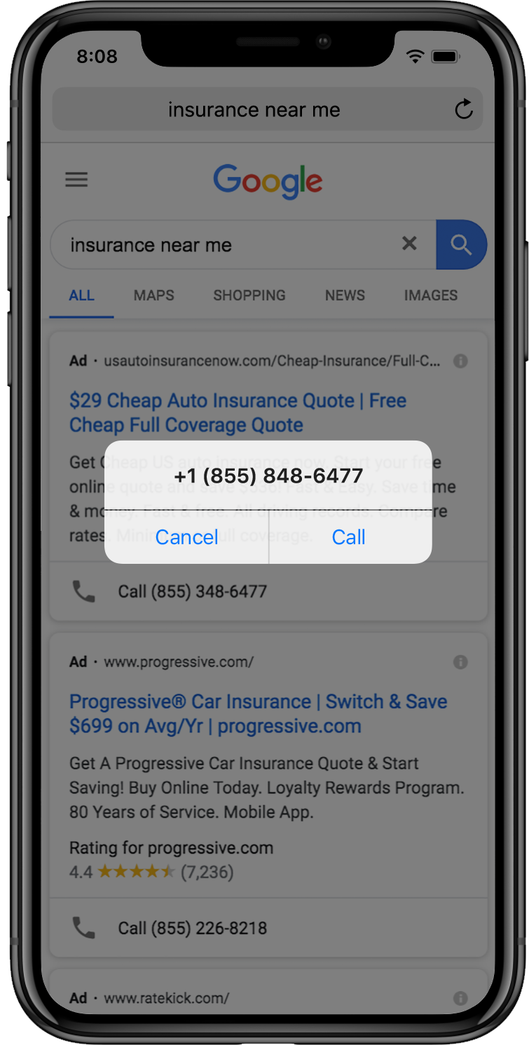
Calls Are Critical Touchpoints for Most Industries
AUTO SERVICE 69% appointments booked by call Source: Cox Automotive |  | HEALTHCARE 88% call to book appointments Source: Sequence |  | HOME SERVICES 31% call to book after searching online Source: Google
BANKING 21% call to buy after searching online Source: Google |  | INSURANCE 38% call to buy after searching online Source: Google |  | LEGAL 66% contact prospective attorneys by calling Source: FindLaw
MORTGAGES 45% call to research or buy Source: Bain & Co |  | SENIOR CARE 70% of consumers convert by calling Source: Invoca |  | TELECOM 32% call to purchase after online search Source: Google
Notes:
From auto to healthcare, home services to retail, financial services to telecom, it’s common for people searching for businesses to engage by calling.
For most industries, a significant percentage of customers want to call to speak with someone as part of the buying process.
And that if you are running campaigns in these industries, a significant percentage of your conversions occur over the phone.

Slide 5
HOW IT WORKS:
Active Conversation
Intelligence

Slide 6

Digital Channels
Contact Center
?
Mobile
Email
Search
Call
Social
Site
Notes:
Present the primary use case and how it’s compounded for franchises

Slide 7
Franchisors Need Flexibility + Simplicity
Centralized View &
Local Personalization
A Data Hub,
Not Data Headaches
Seamless, local experience
Granular intelligence at the franchise or agent level
Centralized and local reporting
Efficient local program execution
Bulk tools for user, data, and phone number management

Slide 8

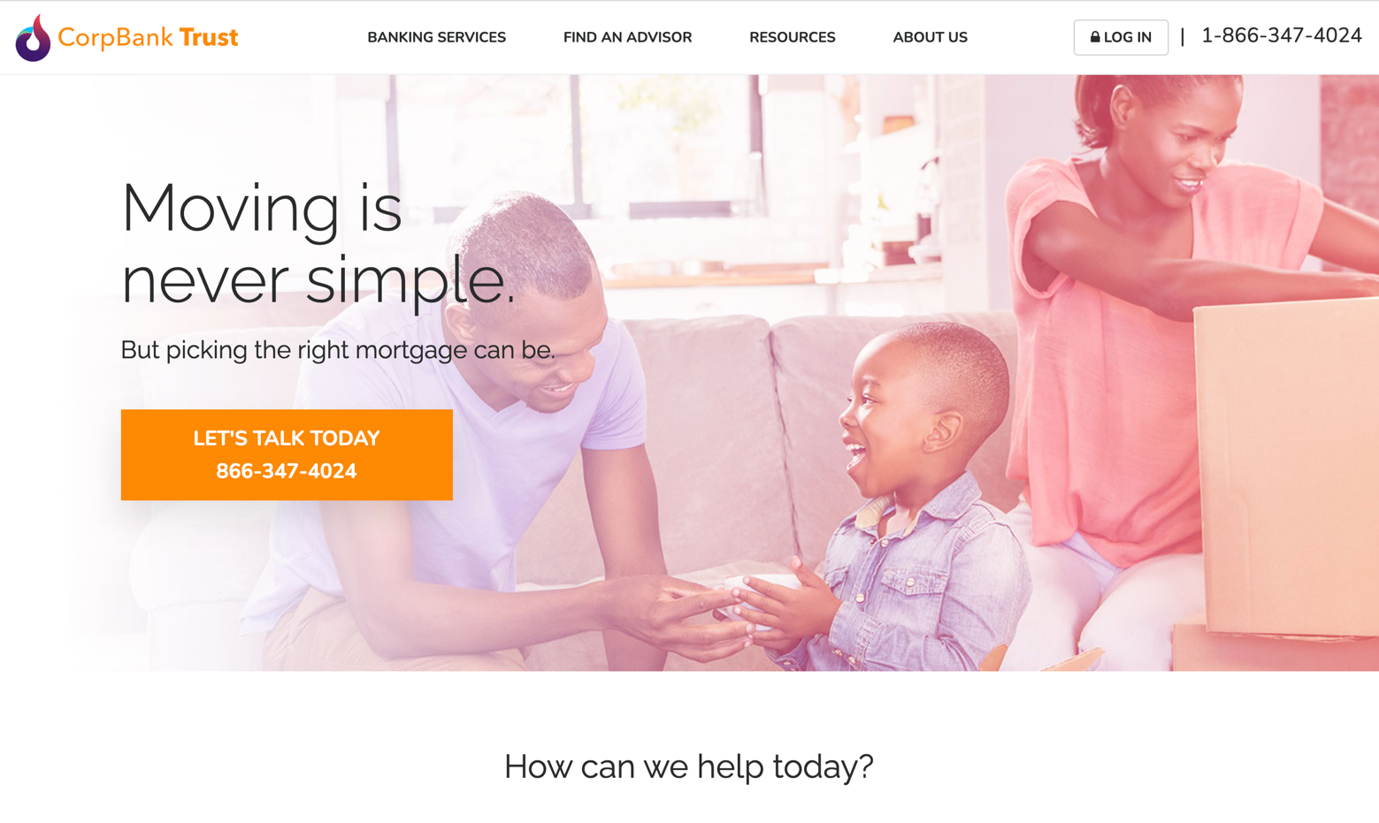
How it Works
[http://www.corpbanktrust.com/?utm_source=google&utm_medium=cpc&utm_campaign=Best%20Rates%20on%20Mortgages]
Campaign data
Dynamic phone number insertion
Cookie data
Dynamic phone number insertion

Slide 9
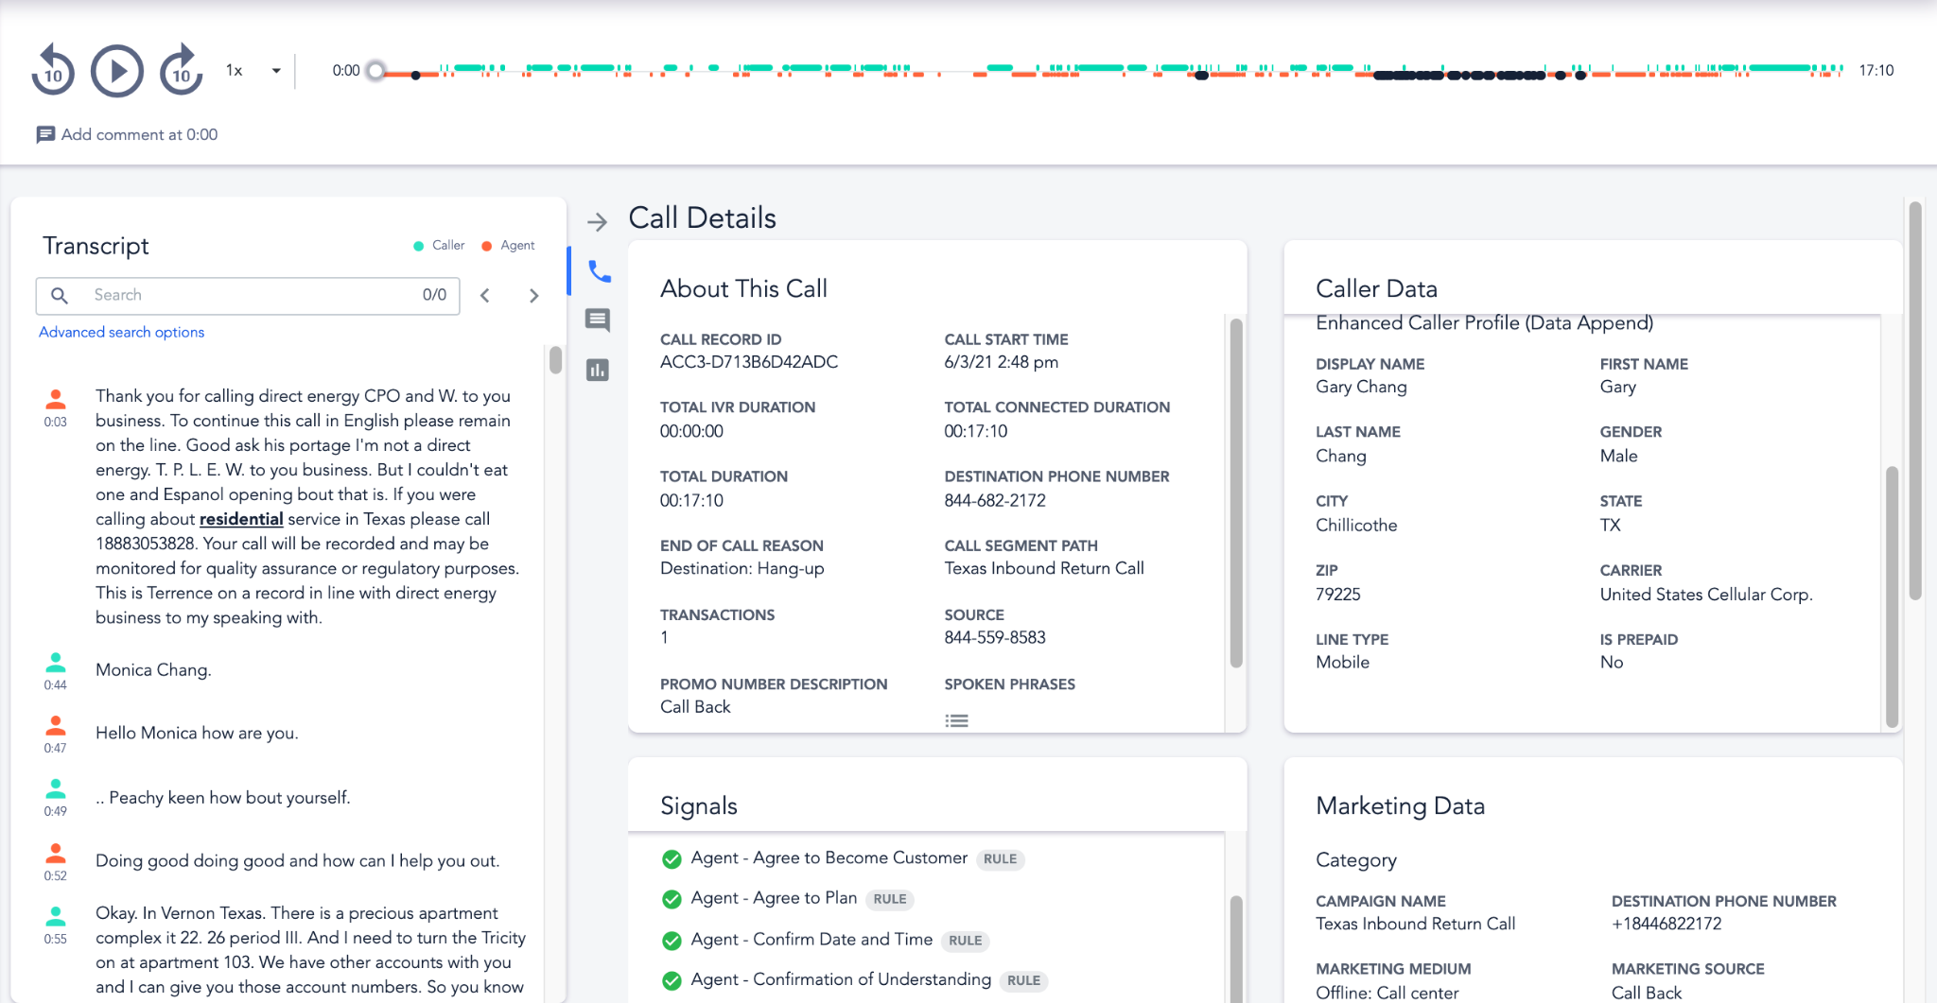
Customer Data in Every Call
Call recording
Third party demographic data
Call details
Searchable transcript
Digital session and matched data
Conversational Signals

Slide 10

Make Smarter Marketing Decisions And Take Action With Conversation Intelligence
Search
Website
Customer:
Campaign:
Interest:
Conversion:
Next Steps:
ID 576431
2021-Q1 Lead Gen
Auto Insurance
No
Add to RT segment
Display
Social
Email
DIGITAL EXPERIENCE
Impressions & Clicks
OFFLINE CALL EXPERIENCE
Conversions & Revenue

Slide 11




Business Benefit of Conversation Intelligence
Marketing
Sales
eCommerce
CX
Drive higher returns and reveal true attribution on digital advertising
Close more of your inbound leads by improving agent effectiveness
Improve digital conversion rates and decrease cart abandonment
Drive growth with revenue-focused insights on the entire buyer experience

Slide 12
The Franchise Challenge

Slide 13
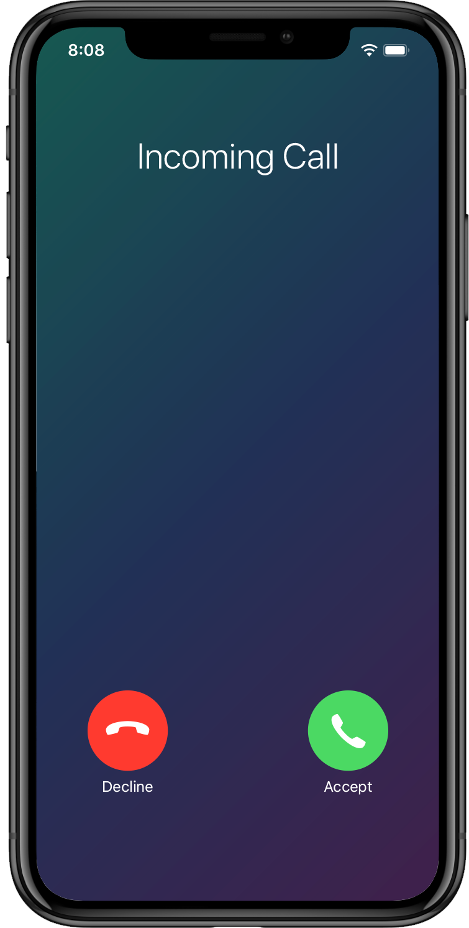
Challenge Marketers Face With Calls to Franchisees
Your franchisees say you aren’t sending them enough quality phone leads and they aren’t seeing a return from their contributions to national marketing fund.
Without your own data on calls to franchisees, you have to take their word for it.
Your marketing performance is reliant on franchisees answering and converting calls, but you can’t tell if they are.

Slide 14



Challenge Marketers Face With Calls to Franchisees
Which campaigns are driving calls?
Who is answering the phone?
Which calls are converting?

Slide 15
Big Questions, Bigger Answers
Which campaigns are driving calls?
Campaign Transparency
Connect calls to the digital journey
Attribution at the campaign, ad and keyword level
Uncover true campaign performance

Slide 16


Leading Insurance Marketplace Drives Huge Gains in Marketing Efficiency
Key Enabling Technologies
Session-level attribution
Signal AI
Google Ads integration
Adobe Analytics integration
Results at a Glance
60%
decrease in click-to-call CPA
20%
decrease in overall CPA
20%
improvement in conversion rate
$3 Million
in cost savings
Insurance

Slide 17
Big Questions, Bigger Answers
Who is answering the phone?
Answer Rate Visibility
Inbound call answer rate
Visibility at the region, franchise and agent level
Re-engage missed conversion opportunities

Slide 18
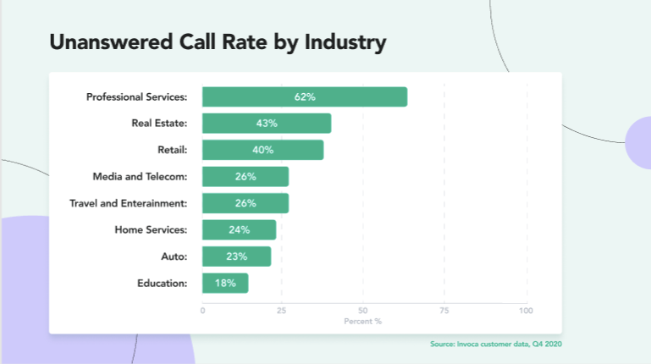
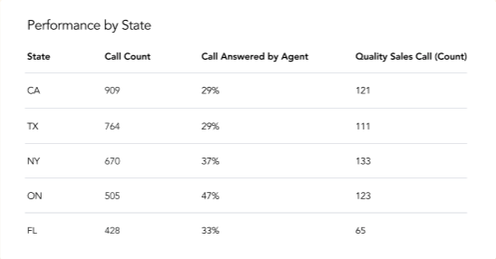
Recover and Re-Engage Unanswered Sales Calls Across All Locations
Unanswered Call Rate by Location
Track Answered Calls Across Every Location
See how many high intent sales calls are missed.
Breathe new life into unanswered phone leads and retarget those callers with incentives.
Troubleshoot what’s driving unanswered calls to increase call rates at every location.

Slide 19


Leading Automotive Customer Captures Missed Revenue Opps at Every Location
Key Enabling Technologies:
Missed Opportunity Signals
“We began to see immediate benefits from Invoca’s Lost Sales Recovery because we have visibility into unanswered sales calls across every location as soon as they occur. From there, our franchisees and their teams are empowered to make callbacks immediately or in the future to increase their booked appointment rate.”
Kate Gardiner, Director of Regional & Local Marketing
Auto

Slide 20
Big Questions, Bigger Answers
Which
calls are converting?
Conversion Rate Data
Optimize for highest-converting campaigns
Reduce wasted media spend
Automate retargeting and suppression

Slide 21


Active Conversation Intelligence drives more leads to its franchisees and increases contact center efficiency.
Key Enabling Technologies
Session-level attribution
Signal AI
Integrations with Google Campaign Manager, Adobe Experience Cloud and Facebook
Results at a Glance
15%
increase in call center efficiency
65%
reduction in spam calls
16%
improvement in media efficiency
“The main reason that we love partnering with Invoca is that it’s an innovation driven company. They’re always doing new things and I don’t ever have to worry about falling behind.”
Nataly Huff, VP of Marketing
Home Services

Slide 22

Let’s Take a Look

Slide 23

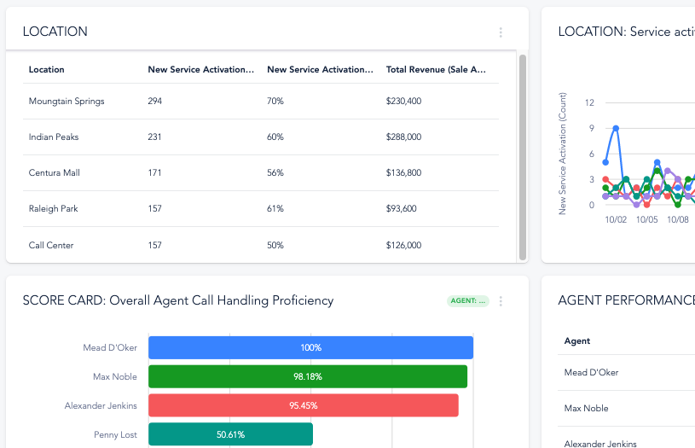
The Benefits of Conversation Intelligence
Understand which leads are driving calls and which are converting
Make data driven decisions that optimize marketing spend and increase conversions and revenue
Visibility into true performance across every franchise

Slide 24
Thank You!
Please visit invoca.com/product/multi-location to learn more

Slide 25
Q&A

