Slide 1


THE FUTURE OF LOYALTY: WHY CUSTOMERS STAY
March 23, 2022
Sponsored By

Slide 2




WEBINAR SPONSOR
Contact The Host
Tom Epstein
Founder & CEO
Franchise Payments Network & POLN8 Loyalty
FPN is an IFA Preferred Vendor
Email Me: LinkedIn: Visit FPN:
tomepstein@steinhouseholdings.com linkedin.com/in/tom-epstein-franpay/ franchisepayments.net/ifa
FPN has been ranked Top Franchise Supplier in Merchant Services by Entrepreneur Magazine four years in a row!

Slide 3
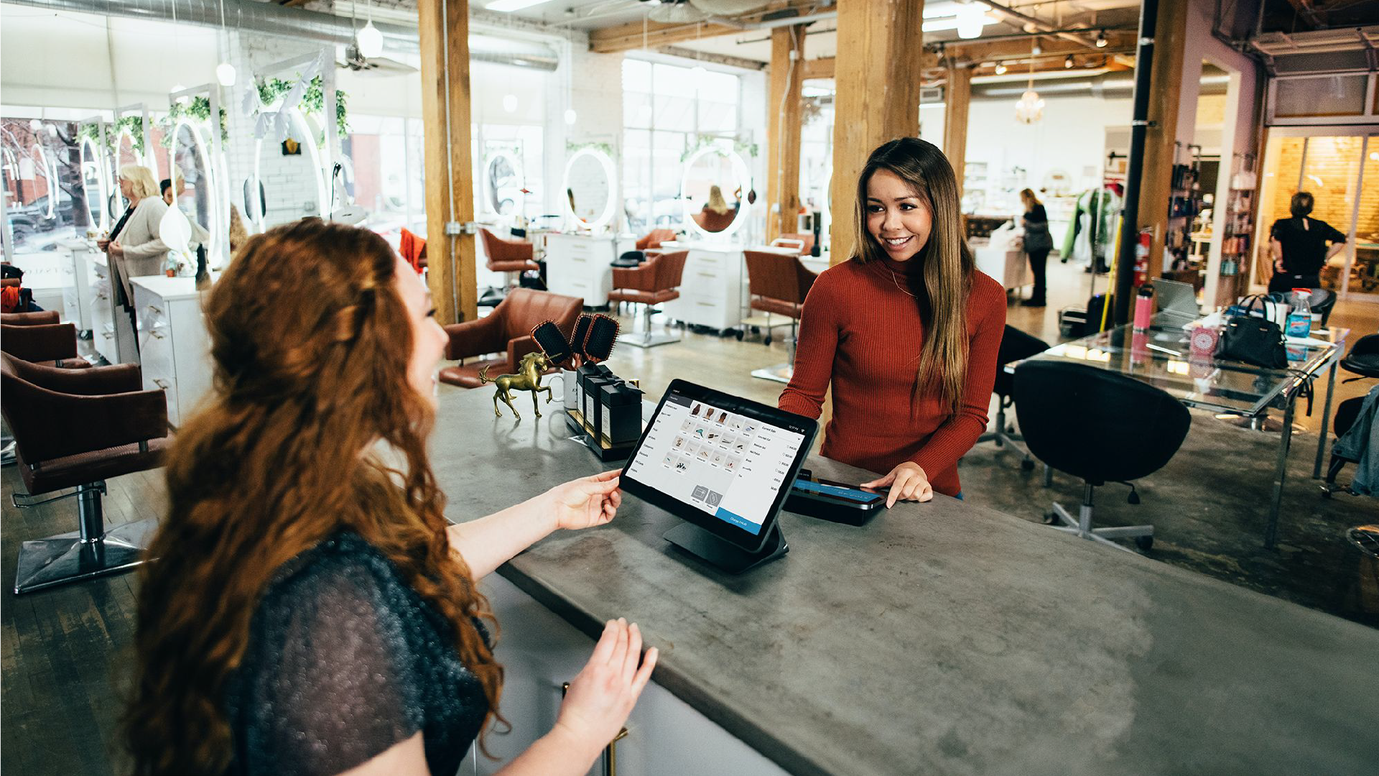
”
“Repeat business or behaviour can be bribed. Loyalty has to be earned.”
Janet Robinson

Slide 4

THE FUTURE OF LOYALTY: WHY CUSTOMERS STAY
The Past, First.

Slide 5

THE FUTURE OF LOYALTY: WHY CUSTOMERS STAY
The Past, First.

Slide 6

THE FUTURE OF LOYALTY: WHY CUSTOMERS STAY
The Past, First.

Slide 7

THE FUTURE OF LOYALTY: WHY CUSTOMERS STAY
The Evolution of Loyalty
& Rewards

Slide 8
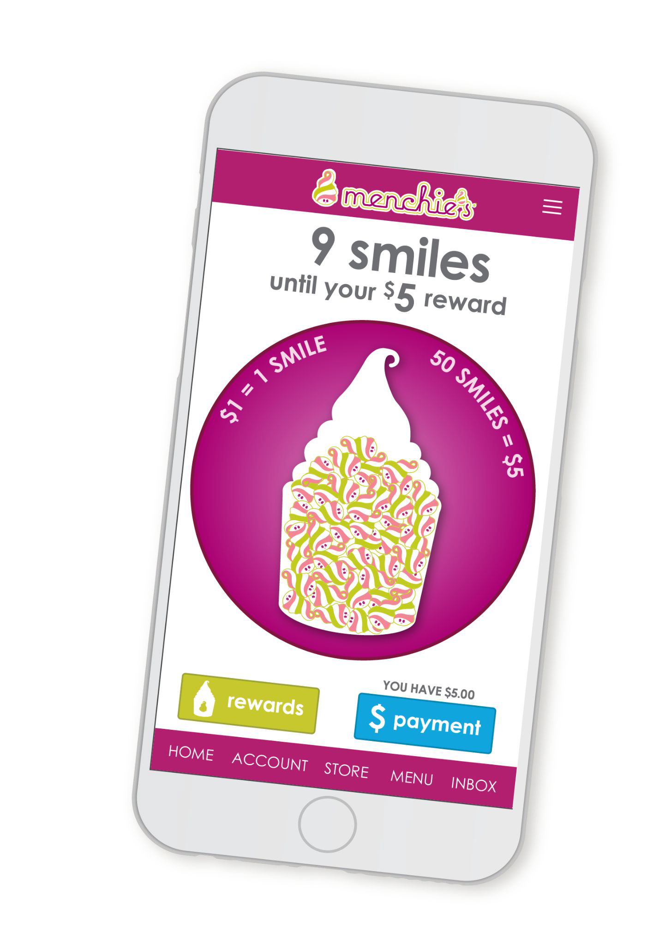
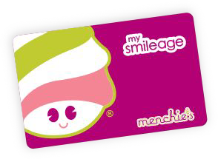
THE FUTURE OF LOYALTY: WHY CUSTOMERS STAY
The Evolution of Loyalty
& Rewards

Slide 9

THE FUTURE OF LOYALTY: WHY CUSTOMERS STAY
What’s Next?

Slide 10

THE FUTURE OF LOYALTY: WHY CUSTOMERS STAY
What’s Next?

Slide 11
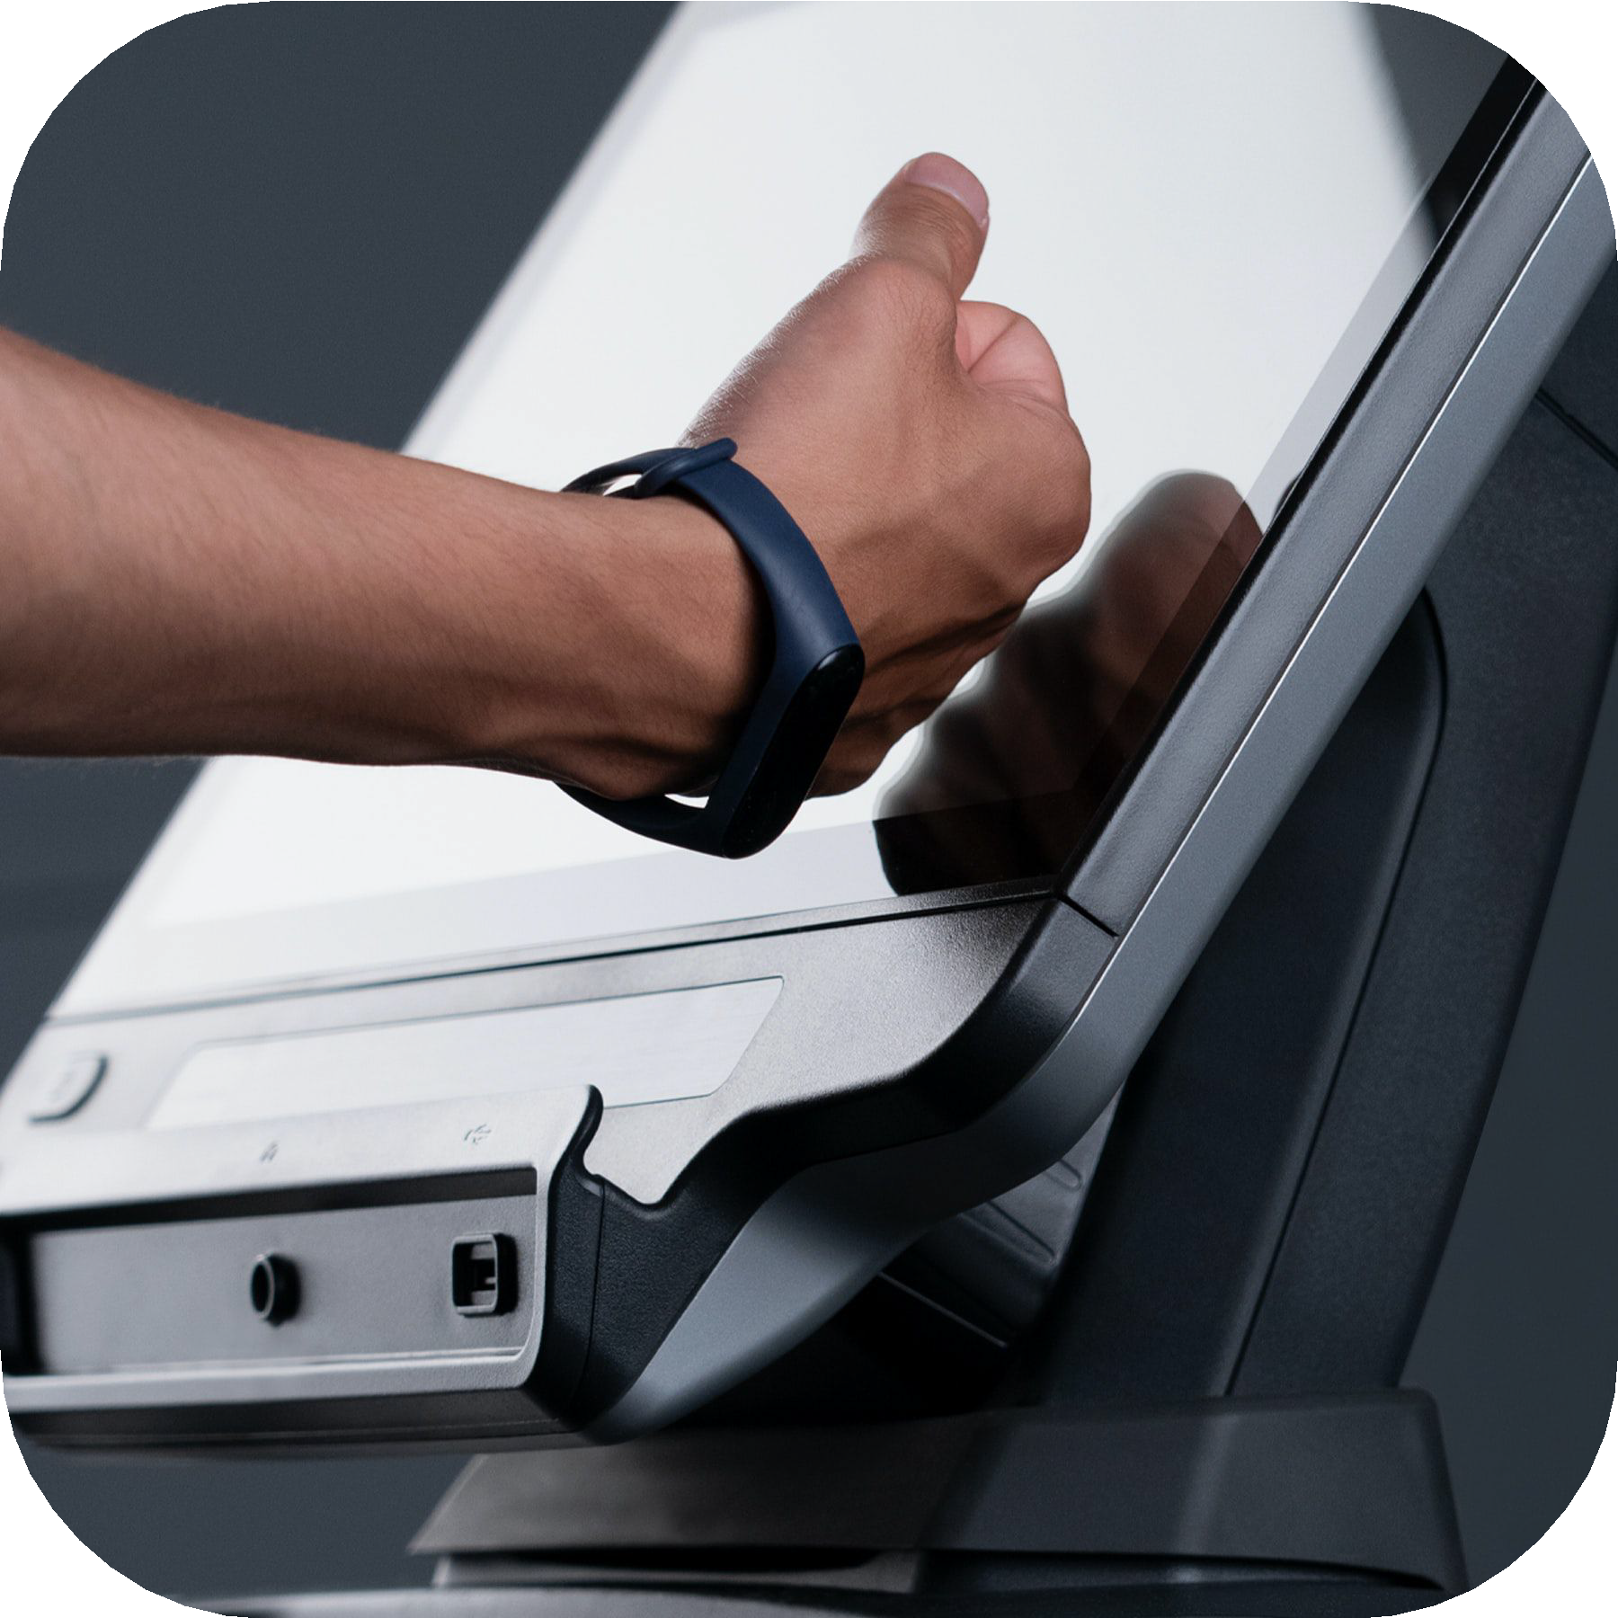
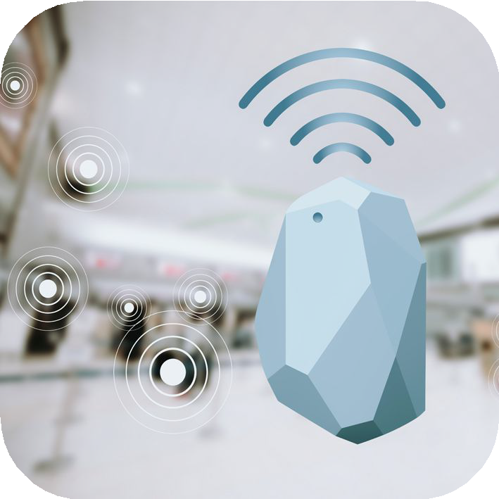
THE FUTURE OF LOYALTY: WHY CUSTOMERS STAY
What’s Next?

Slide 12

THE FUTURE OF LOYALTY: WHY CUSTOMERS STAY
Nothing Ever Changes, Except for the Tools.

Slide 13

THE FUTURE OF LOYALTY: WHY CUSTOMERS STAY
Questions?

Slide 14
THE FUTURE OF LOYALTY: WHY CUSTOMERS STAY
Thank You For Attending!
Tom Epstein
Founder & CEO
Franchise Payments Network & POLN8 Loyalty
FPN is an IFA Preferred Vendor
Email Me: LinkedIn: Visit FPN:
tomepstein@steinhouseholdings.com linkedin.com/in/tom-epstein-franpay/ franchisepayments.net/ifa
FPN has been ranked Top Franchise Supplier in Merchant Services by Entrepreneur Magazine four years in a row!

