Slide 1


Sales tax on autopilot

Slide 2





Merchants are reluctant tax collectors
Mismanagement of sales tax is a leading reason SMBs fail
Merchants gain no direct benefit from collecting sales tax
It's absurd that we use a manual process in a digital age
© Avalara. Confidential and proprietary.

Slide 3

What is sales tax?
Coffee: $4.00
Sales Tax: $ .32
Total: $4.32
And who owns it?

Slide 4
The problems of sales tax
Cash management - sales tax funds are frequently used as working capital
Restaurants double paying sales tax with 3rd party apps
Frequent return filing and remittances (monthly/quarterly)
Excessive fines and penalties for late sales tax payments
© Avalara. Confidential and proprietary.

Slide 5
DAVO solves the problem
Cash management - sales tax funds are frequently used as working capital
  Automatically sets sales tax aside daily
Frequent return filing and remittances (monthly/quarterly)
  Seamlessly files and pays sales tax when due
Excessive fines and penalties for late sales tax payments
  Guarantees sales tax is paid on time
© Avalara. Confidential and proprietary.

Slide 6





How DAVO by Avalara automates sales tax
Point of Sale
Partners
Merchant Bank
Account
Daily Tax Set-Aside
Daily Sales Data
DAVO's Secure Tax
Holding Account
Monthly / Quarterly
Tax Remittance
Clover • Square • Toast Lightspeed • Upserve
Vend • SpotOn • Heartland
Par Brink • Poynt • Revel OVVI • Quickbooks
State Department
of Revenue
Monthly / Quarterly
Tax Returns
© Avalara. Confidential and proprietary.

Slide 7
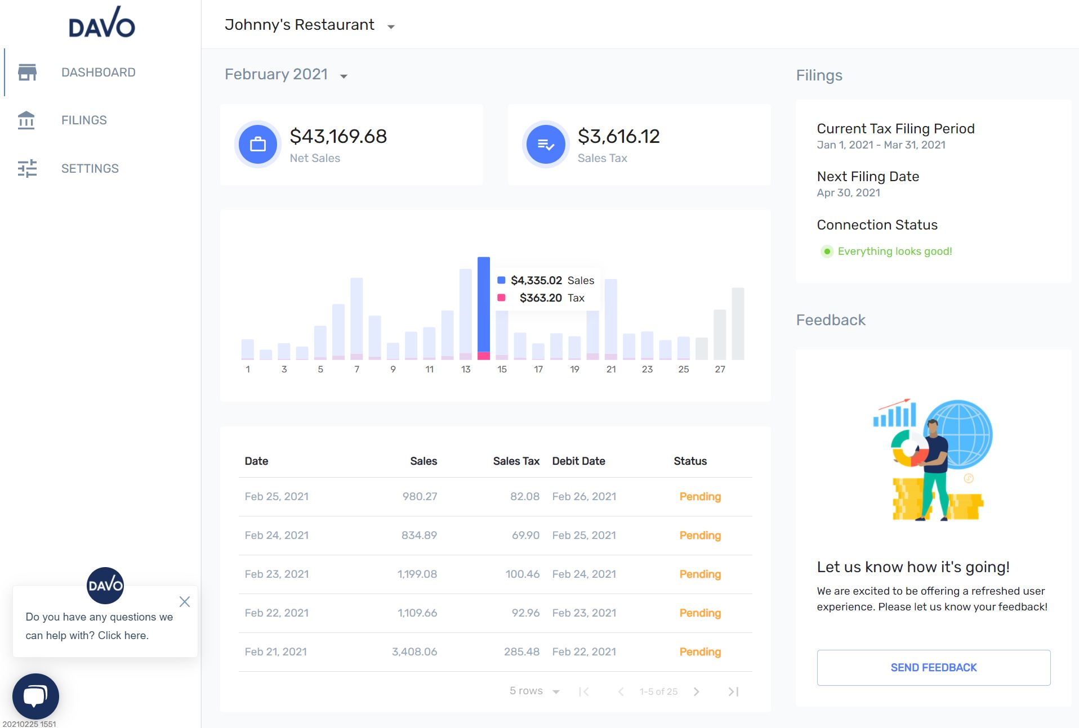
DAVO Merchant Dashboard
© Avalara. Confidential and proprietary.

Slide 8
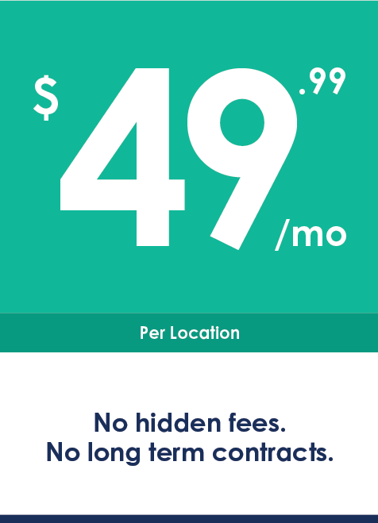
Benefits and pricing
Automatically sets sales tax aside daily
Transaction level sales data ensures accuracy
Guaranteed on-time return filing and payments
State filing discounts refunded where applicable
Sales records and tax document storage
Efficient use of resources
Multi-unit discounts available
First Month
FREE
davosalestax.com
© Avalara. Confidential and proprietary.

Slide 9
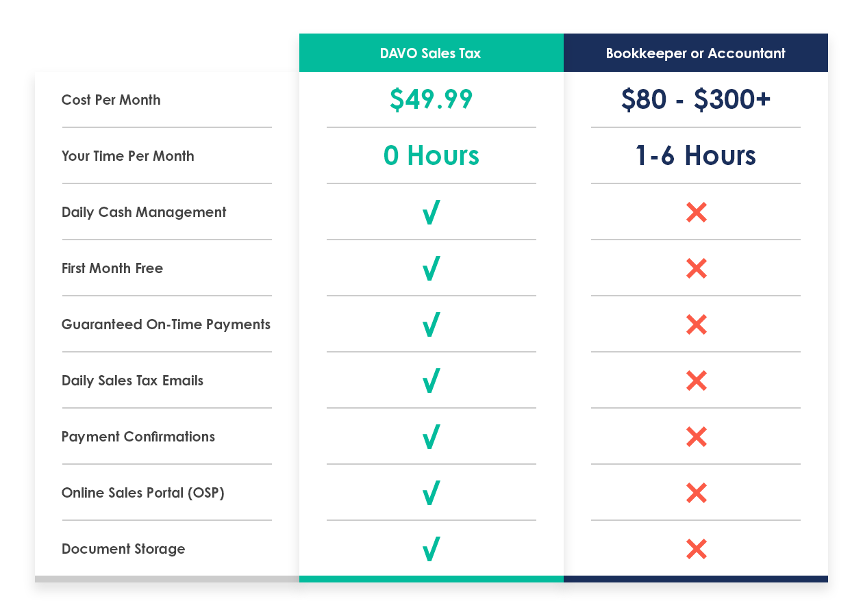
Automation vs. manual
Fully automated end-to-end
Set it and forget it
Reduced risk
Guaranteed on-time payments
Affordable - $49.99/month per location
Less than a bookkeeper or accountant
Less than 2 hours of your time
© Avalara. Confidential and proprietary.

Slide 10
On-time filing discounts available in 26 states
State | Percentage Discount | Discount on $3,500 of Sales Tax | Minus $50 Cost of DAVO
AL | 5% on First $100 Tax Due; 2% on Balance | $73 | $23
AZ | .0672% of Tax Due | $23.52 | ($26.48)
AR | 2% of Tax Due | $70 | $20
CO | 3.33% of Tax Due | $116 | $66
FL | 2.5% of 1st $1,200 | $30 | ($20)
GA | 3% of 1st $3,000; 0.5% on Balance | $92.60 | $43
IL | 1.75% on Tax Due | $61.25 | $11.25
IN | 0.73% Under $60,000 | $25.55 | ($24)
KY | 1.75% 1st $1,000; 1.5% remaining amount; Max refund is $50 | $30 | ($20)
LA | 1.1% of Tax Due | $38.50 | ($12)
MD | 1.2% of 1st $6,000 | $42 | ($8)
MI | ~0.6667% $6/Month up to $1,200 | $21.33 | ($29)
MS | 2% up to $50/Return | $50 | $0
MO | 2% of Tax Due | $70 | $20
NE | 2.5% up to $75/Month | $75 | $25
NV | 0.25% of Total | $8.75 | ($41)
NY | 5% up to $200 Qtrly or Annually | $200 | $150
ND | 1.5% up to $110/Return | $52.50 | $2.50
OH | 0.75% of Tax Due | $26.25 | ($23.75)
PA | 1% on Total Due | $35 | ($15)
SD | 1.75% up to $70/Filing | $61.25 | $11
TX | 0.5% on the Total | $17.50 | ($32.50)
UT | 1.31% on Total | $45.85 | ($34.15)
VA | 1.6% on Total | $56 | $6
WI | 0.5% Max $1,000 | $17.50 | ($32.50)
WY | 1.95% to $6,250 Then 1% to $500 | $68.25 | $18
DAVO returns on-time filing state refunds to merchants where available
This often covers the cost of DAVO with
money to spare
© Avalara. Confidential and proprietary.
This chart is for informational purposes only and is subject to change without notice

Slide 11
3rd party delivery apps for restaurants
Ask your 3rd party apps who is responsible for collecting and remitting sales tax.​
If you are responsible: If 3rd party app is collecting sales tax and remitting it to you, create a taxable order type in your POS.​
If 3rd party app is responsible: If the 3rd party app is collecting and remitting sales tax on their orders, create a non-taxable order type in your POS.​
Enter orders as usual. ​
Read more: davosalestax.com/how-to-integrate-3rd-party-apps-to-pos/
© Avalara. Confidential and proprietary.

Slide 12
Who should be using DAVO?
Restaurants | Retailers | Service
Quickserve | Liquor Stores | Automotive
Fine Dining | Clothing | Salons
Fast Casual | Gift Shops | Spas
Ice Cream | Toy & Hobby | Fitness
Coffee | Discount | Dental
Bakery | Florists | Veterinary
Pizza | Pet Stores
Breweries | Sporting Goods
Pubs
© Avalara. Confidential and proprietary.

Slide 13
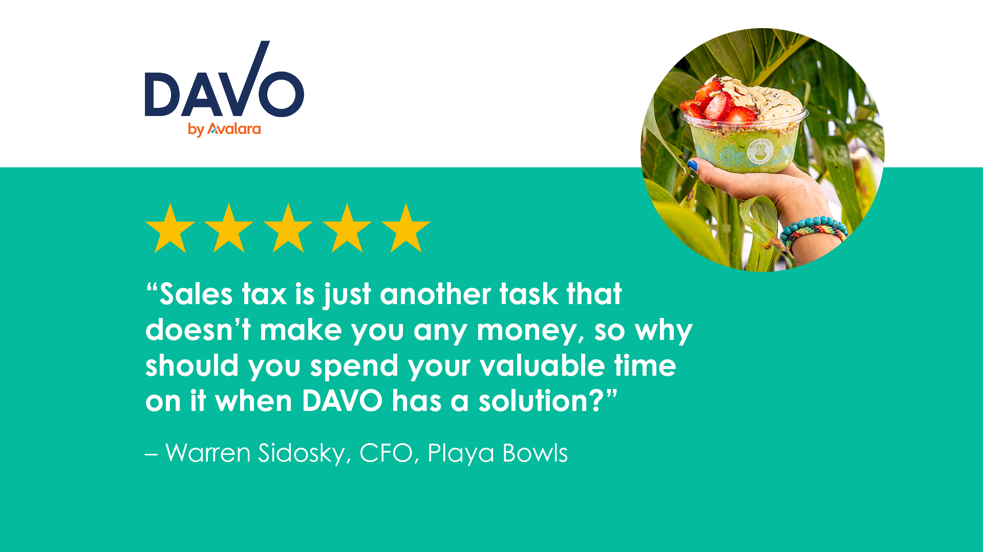

Slide 14
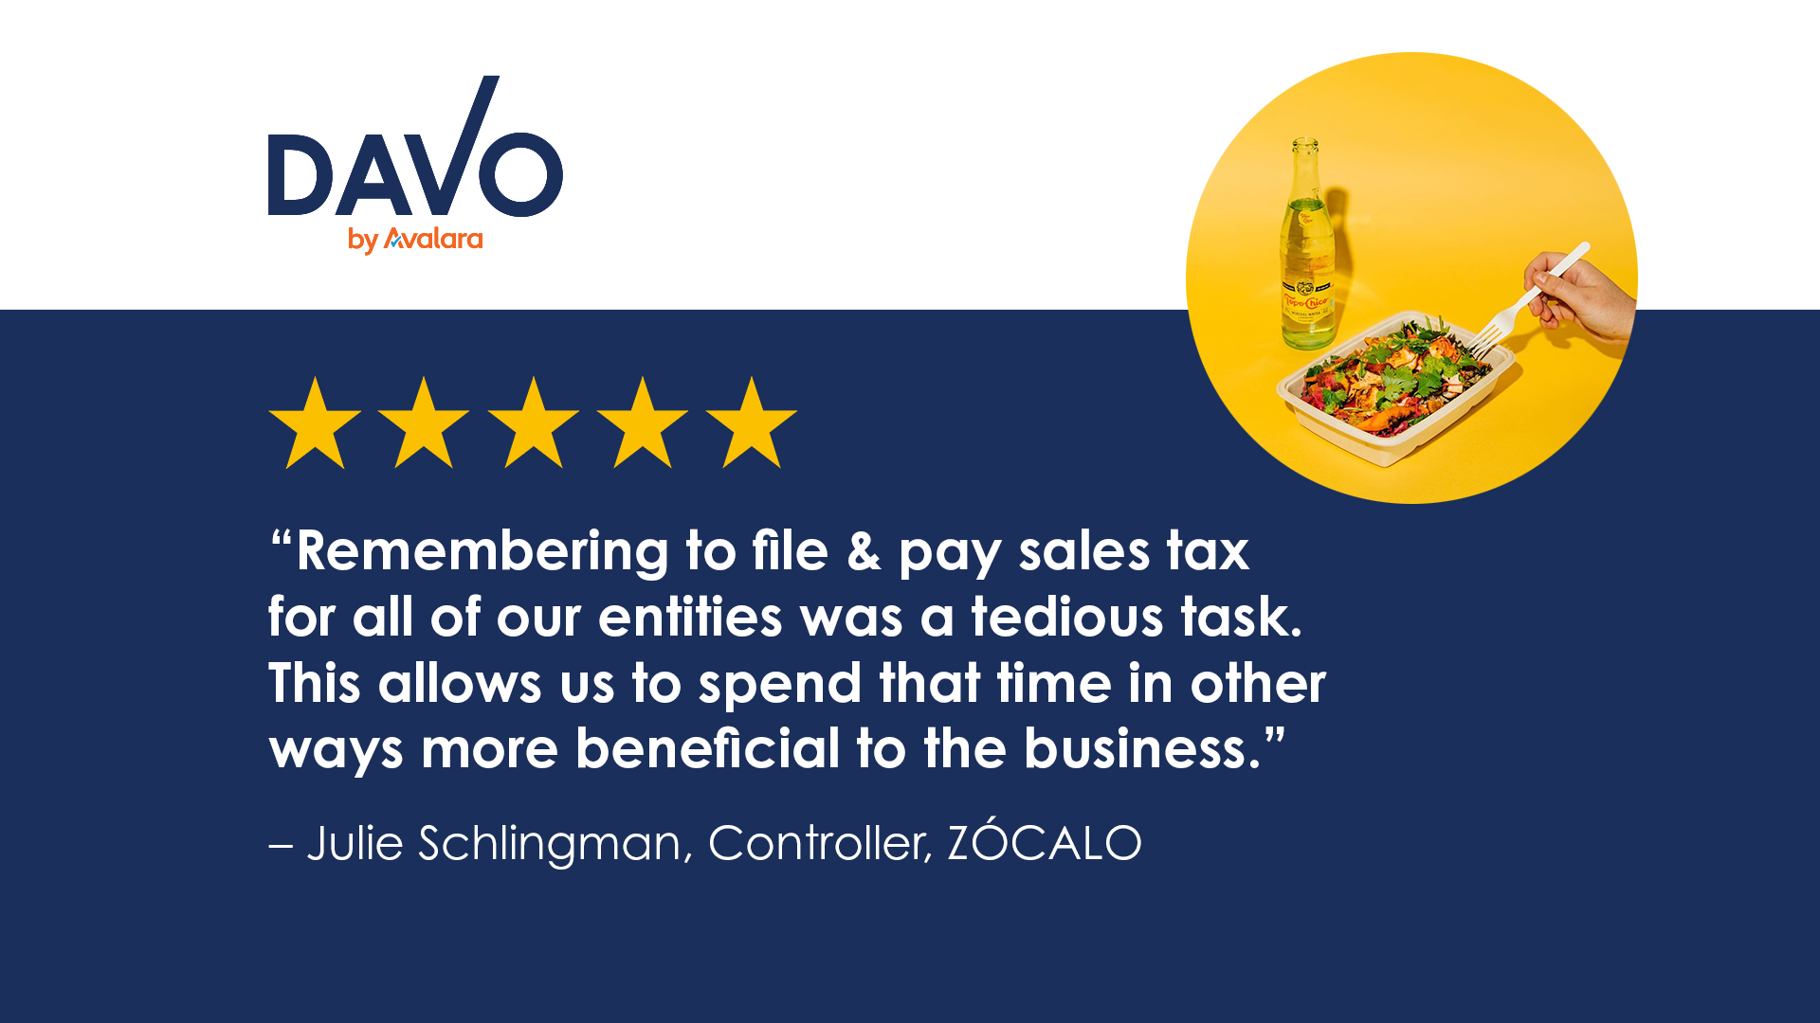

Slide 15



Our customers say DAVO is a “must have”
4.9 of 5
4.7 of 5
5 of 5
© Avalara. Confidential and proprietary.

Slide 16
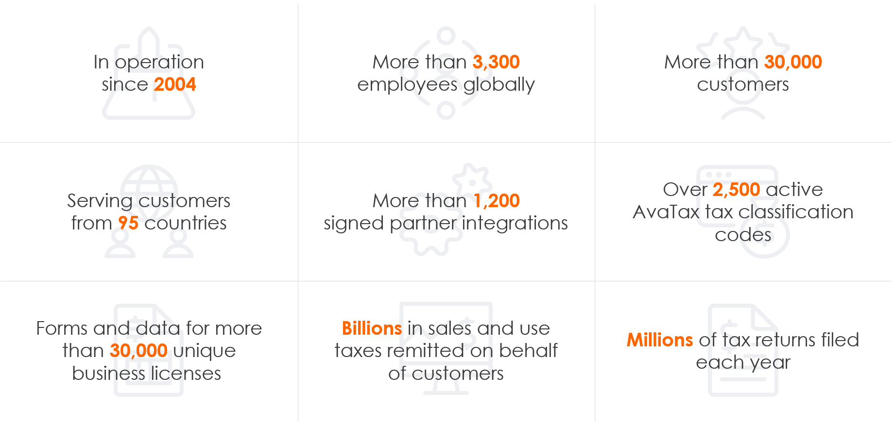
About Avalara (NYSE: AVLR)
© Avalara. Confidential and proprietary.

Slide 17
davosalestax.com
Contact:
David Joseph – Co-Founder
david.joseph@avalara.com
Bilingual DAVO support:
support@davosalestax.com
(888)659-8432
© Avalara. Confidential and proprietary.

Slide 18
Sales tax on autopilot

