Slide 1




Supplier Agreements – Strategies for Building Stronger Contracts During Turbulent Times
IFA WEBINAR SERIES
March 7, 2023
SPONSORED BY:

Slide 2
Webinar Sponsor
www.gtlaw.com

Slide 3
POLL QUESTION
Has your business been negatively impacted by supply chain delays/disruptions within the past two years?

Slide 4
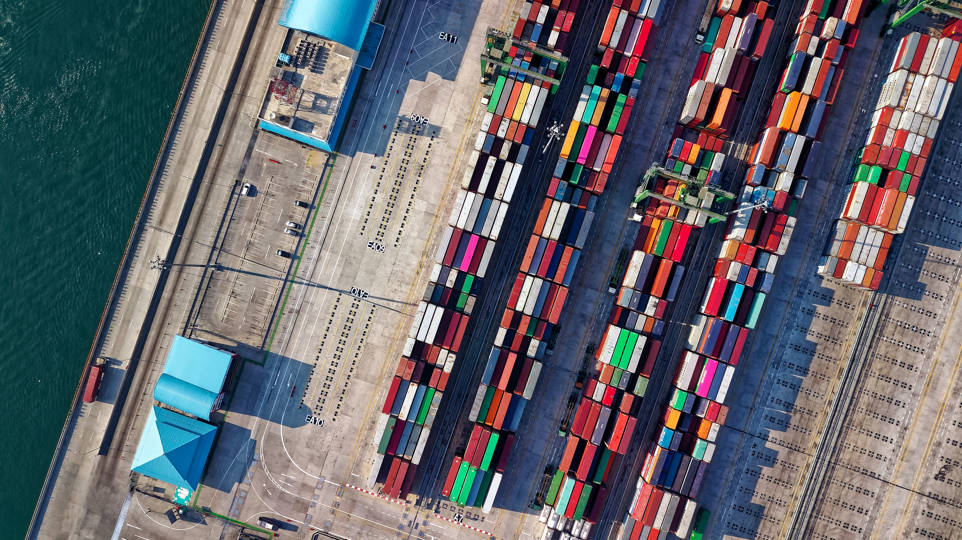
AGENDA
How did we get here?
Why do we need to focus on our supply chain?
What can we do?

Slide 5

How did we get here?
Labor Shortages
  COVID-19 outbreaks and mandated shutdowns
  Resistance against return to work
  Demand for workers exceeds applicants
Transportation Issues
  Shipping container shortages
  Storage cost increases
  Freight delays
Globalization of Supply Chains
  Supply chain issues can’t be compartmentalized
Inherent Volatility of JIT Supply Chain Strategy
  Lack of on-hand inventory

Slide 6
GLOBAL SUPPLY CHAIN DISRUPTIONS
© Statista 2023
* Data was gathered from Statista’s EventWatch AI, a 24/7 global event monitoring service that contextualizes and analyzes more than 1.7 billion news feeds about potential and existing supply chain disruptions from approximately 4.2 million sources in 100 languages, including daily news, government regulatory reports, and social media.
Figures prior to 2021 were taken from previous releases.

Slide 7




Why do we need to focus on supply chain?
BRAND IMAGE AND LOYALTY
CONTINUITY OF SUPPLY
COST OF GOODS SOLD
QUALITY ASSURANCE

Slide 8
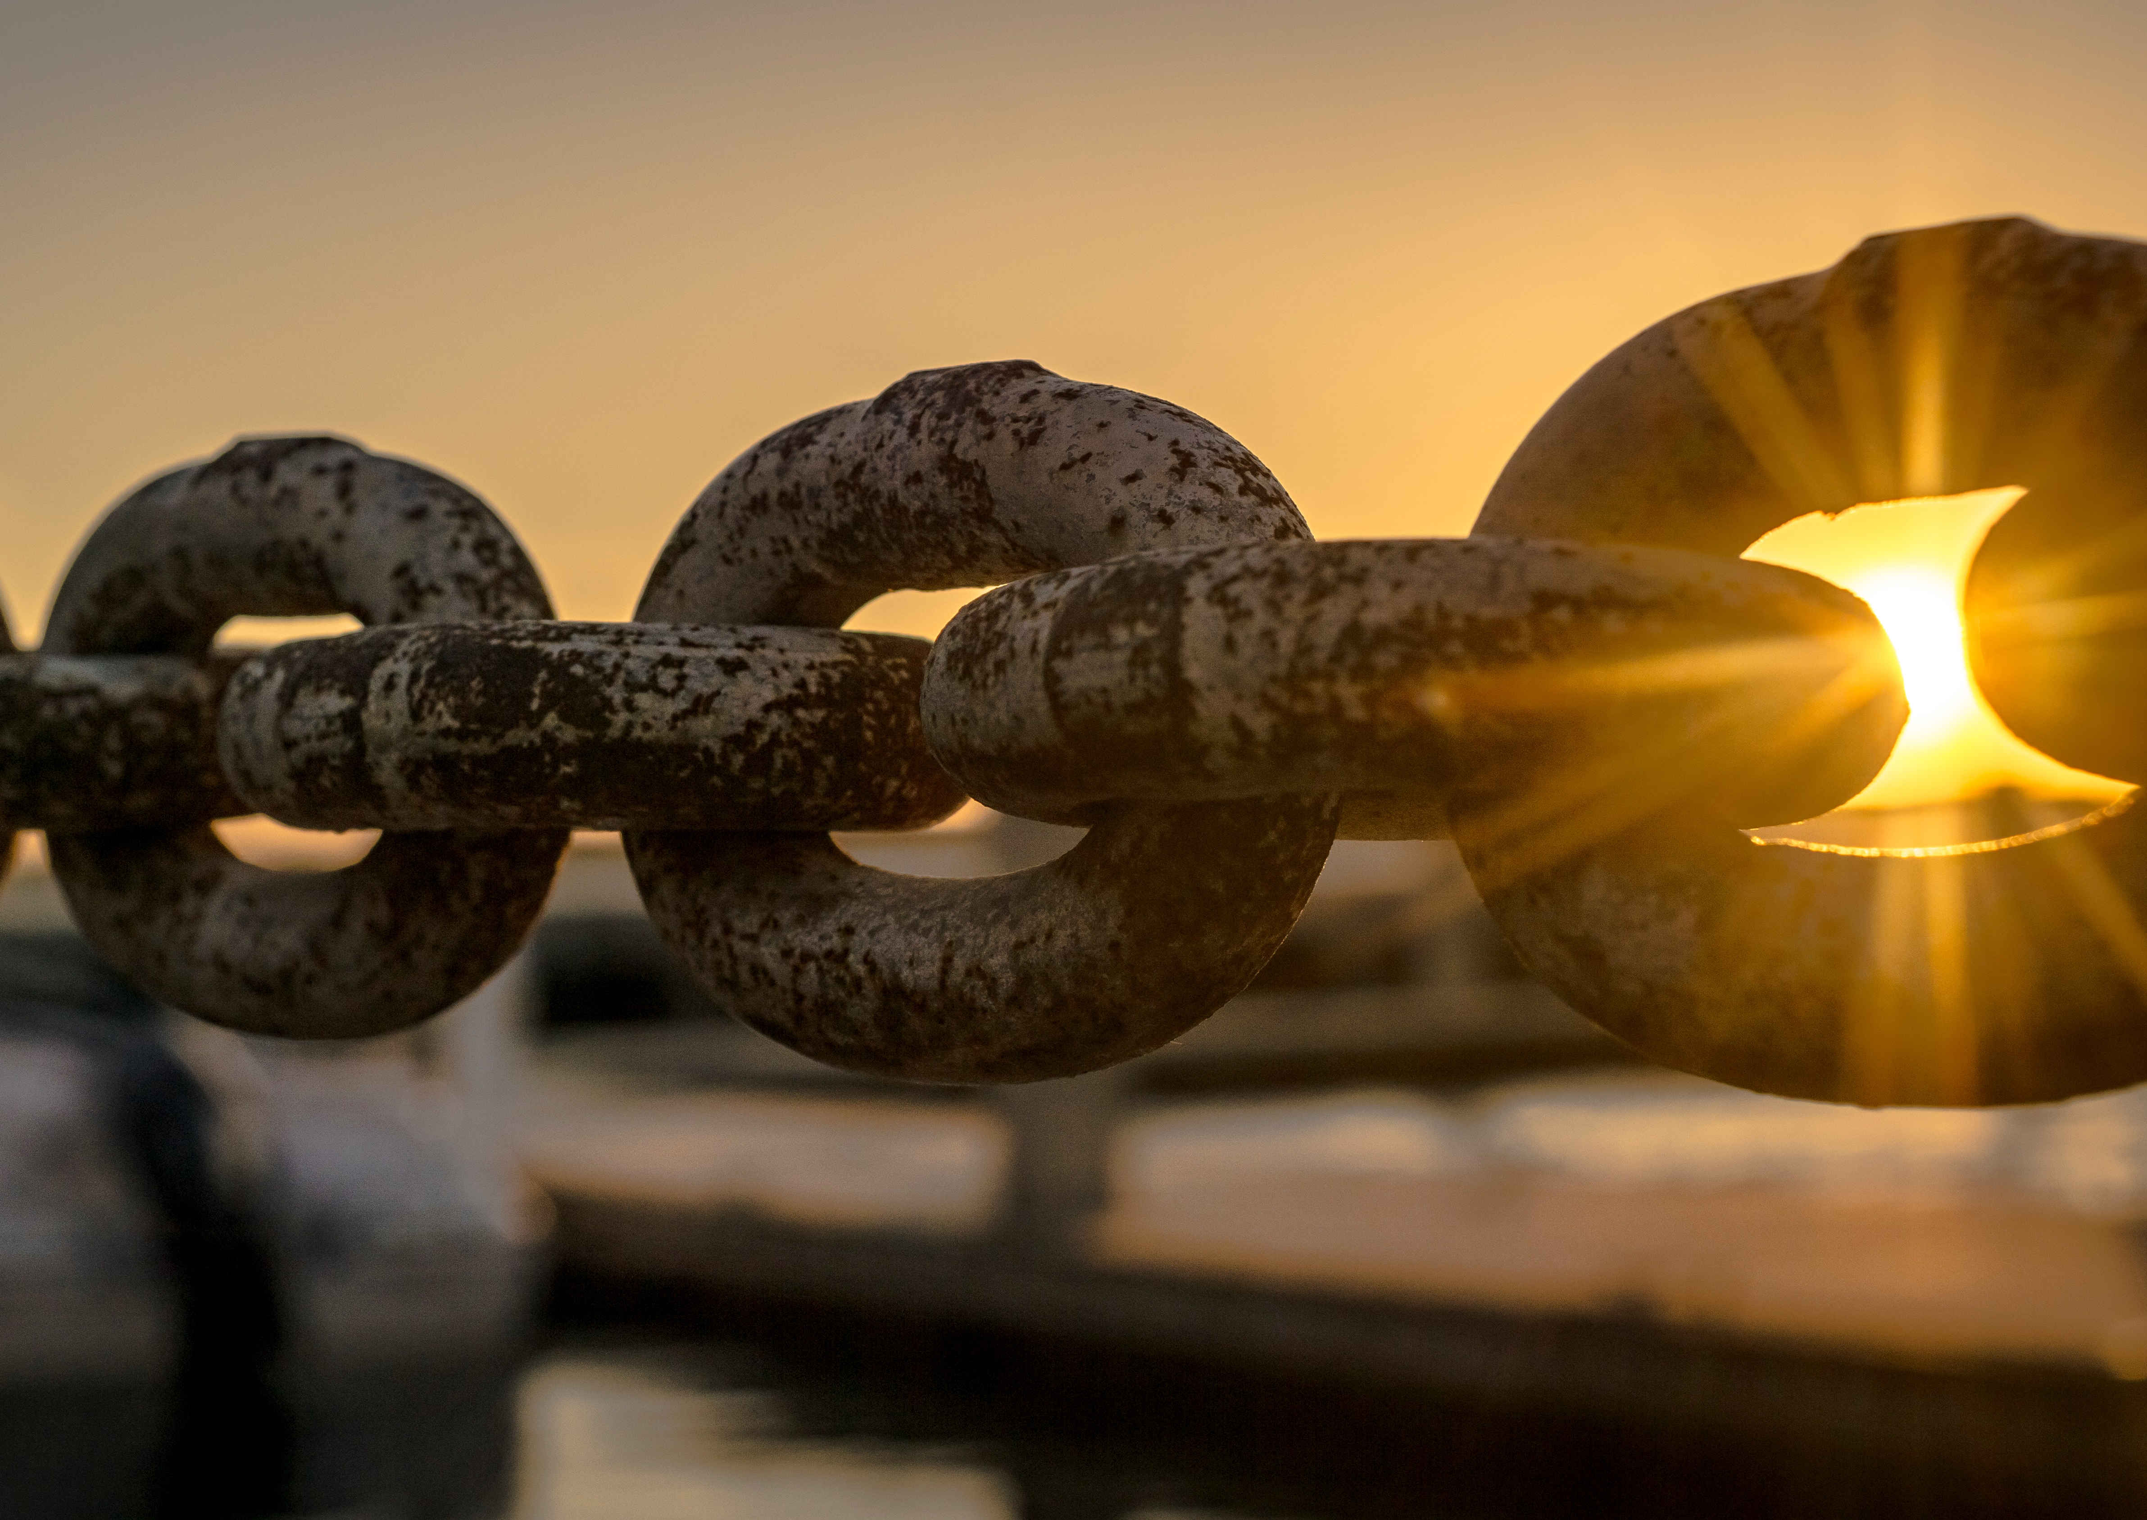
What can we do?
Take a closer look at your contracts
  Do we have a contract in place?
  The days of informality and handshake deals are over.
Dust off your templates
  The world has changed, and we need to make sure that our agreements change with it.
Start off strong, but be mindful
  If possible, start with your own form of agreement to put yourself in a more favorable position at the onset.
  Be aware of the amount of leverage you possess but be cognizant on the impact to the business relationship.

Slide 9
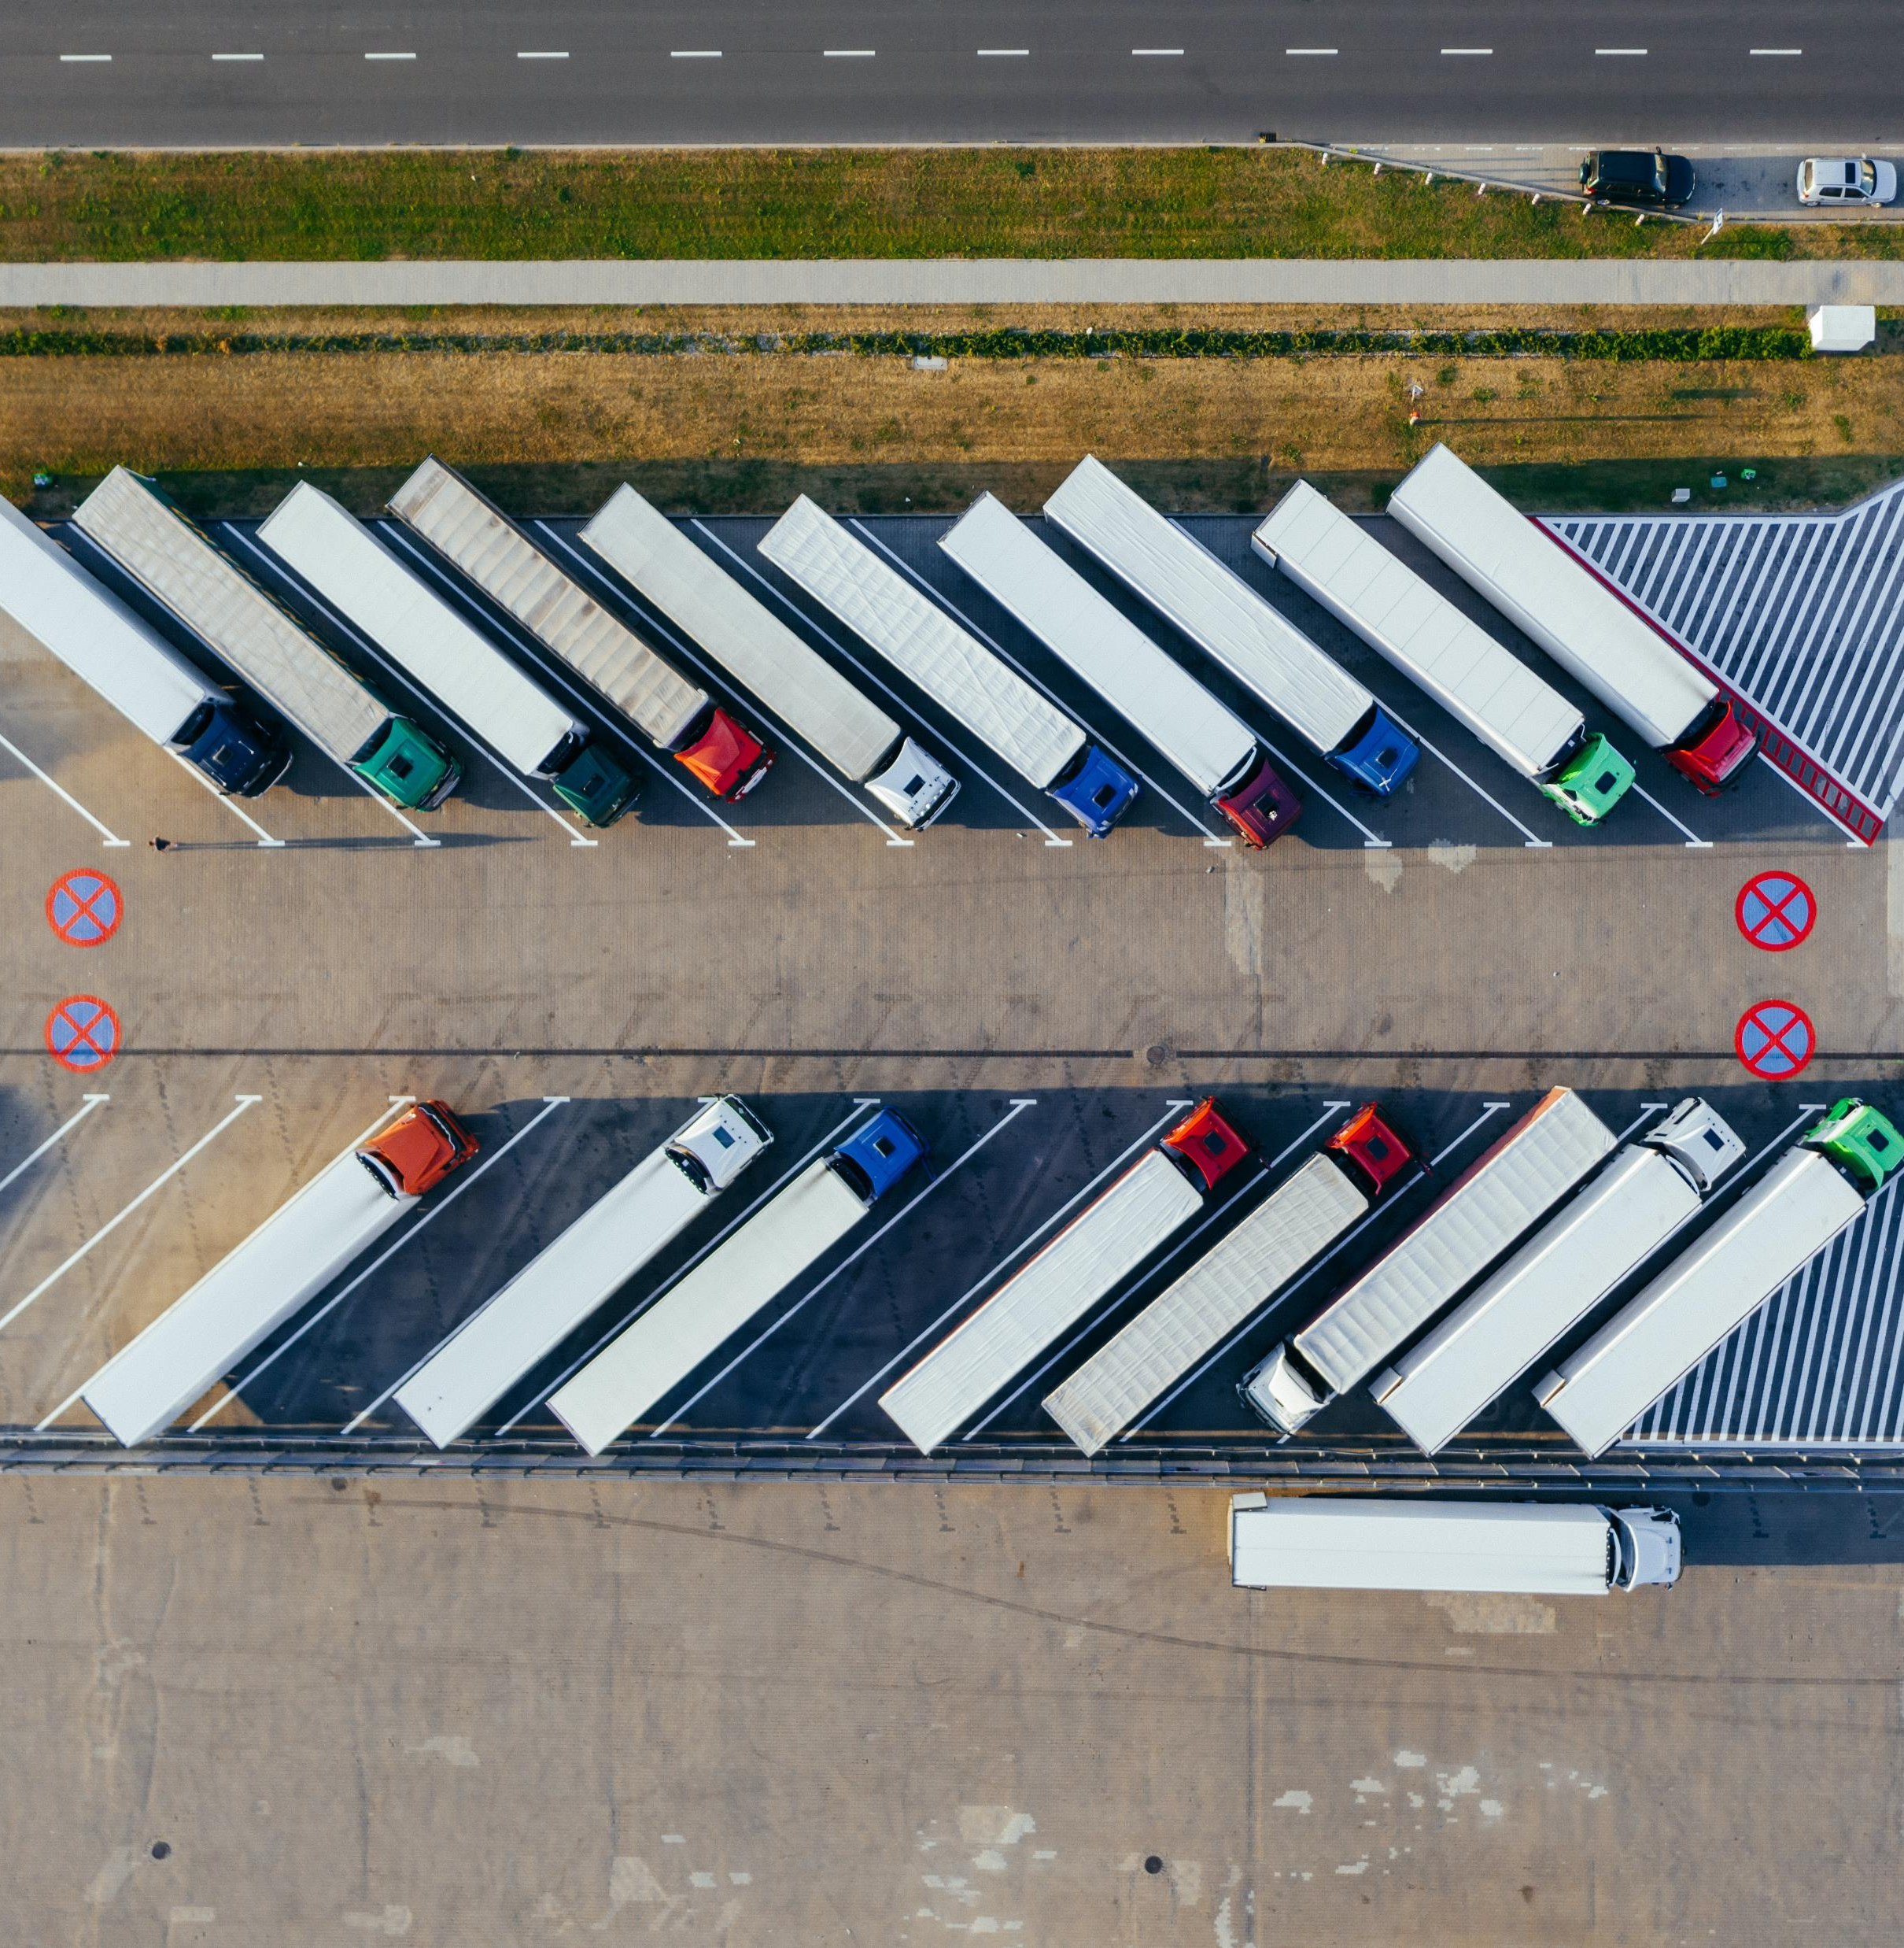
FORCE MAJEURE
Force majeure removes liability for unforeseeable and unavoidable events that prevent a party from fulfilling their obligations under a contract.
Natural disasters
Fire
War or civil unrest
Floods
COVID
Labor issues
Material cost increases
Supply chain disruptions

Slide 10
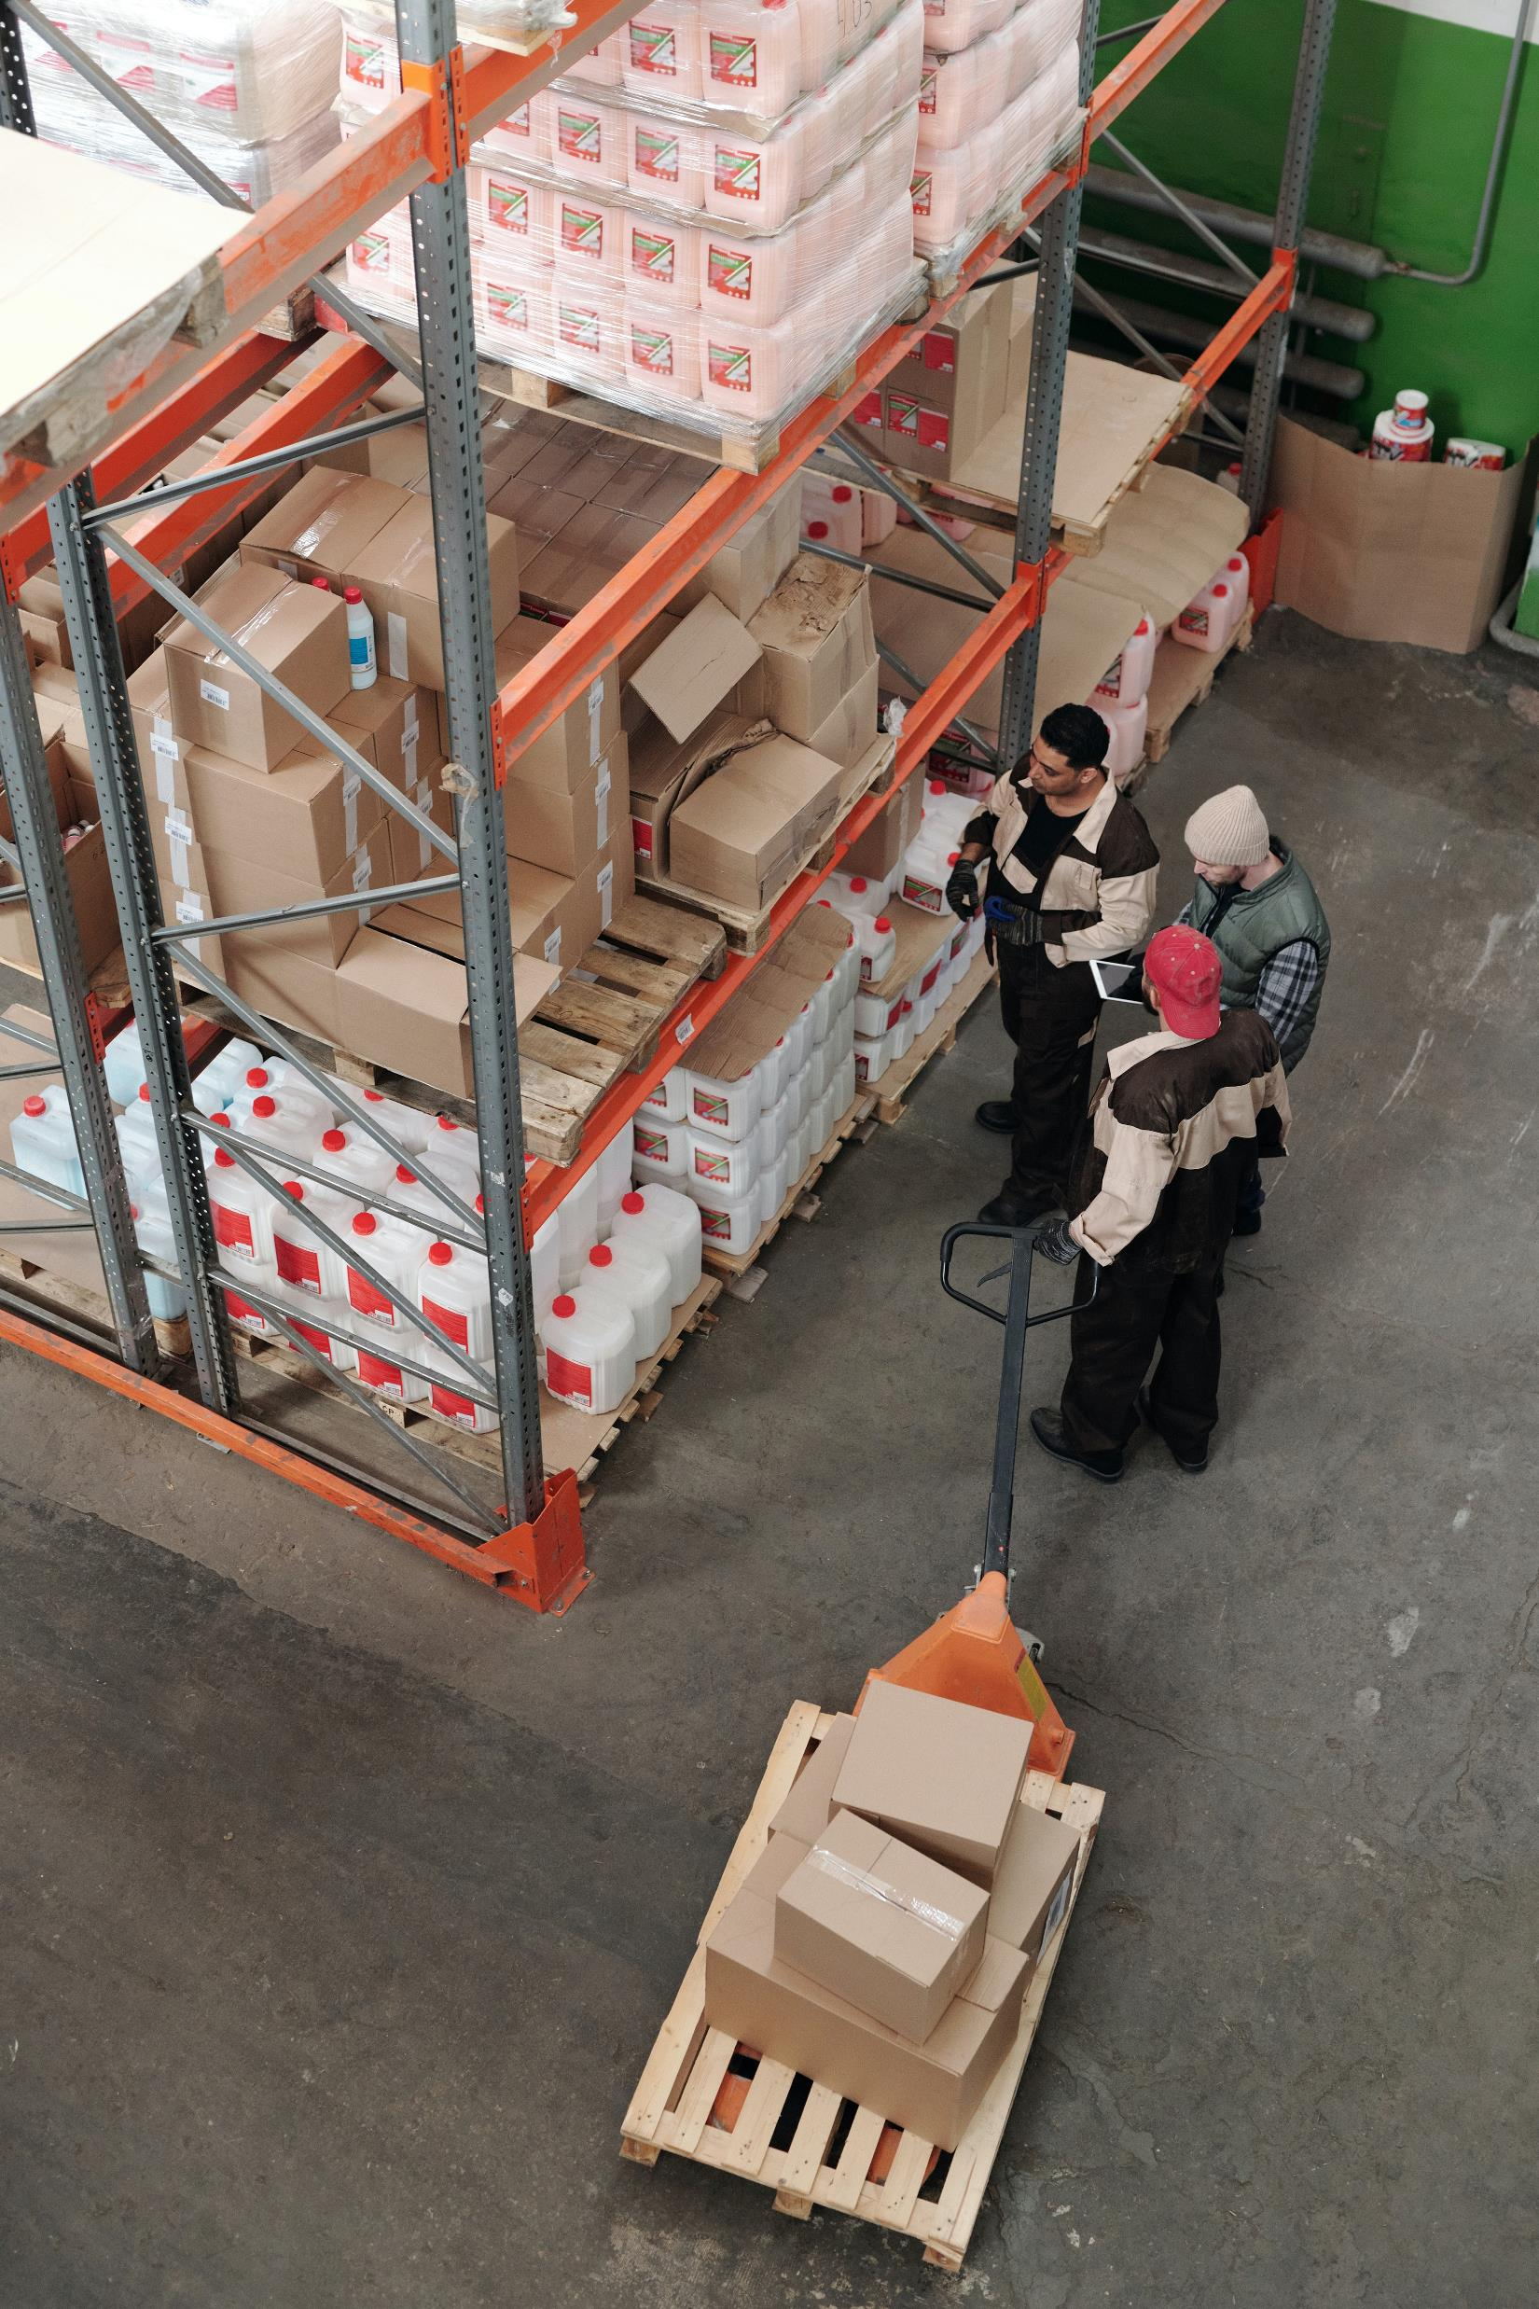
REPLACEMENT DAMAGES
Applies in situations where a supplier fails to meet its delivery obligations for reasons other than a force majeure event
Allows a company to obtain a replacement supplier and recover the difference between what was paid to the replacement supplier and what would have been paid to the original supplier
Not intended to be punitive, but rather to put the company in the place it would have been had the supplier met its delivery obligations

Slide 11
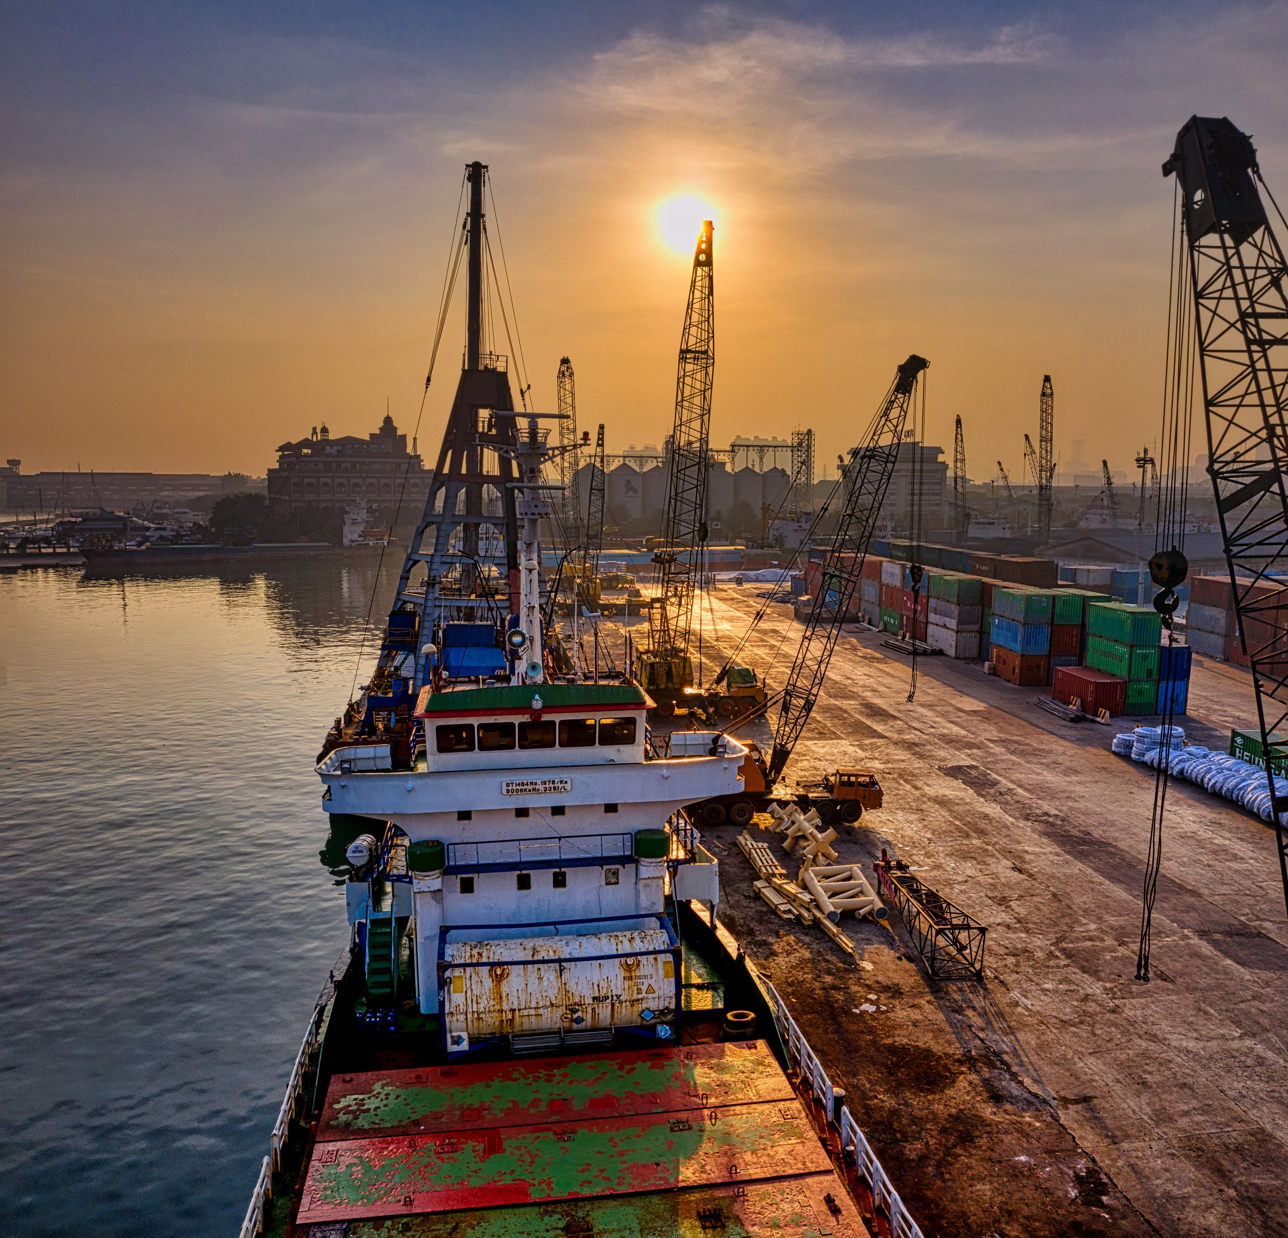
PRICE CHANGES
Expressly state that all price changes are subject to mutual agreement and clarify what happens if the parties can’t agree
Link any price increases to an applicable index
If all else fails, set a cap on the number and/or amount of any price increase

Slide 12
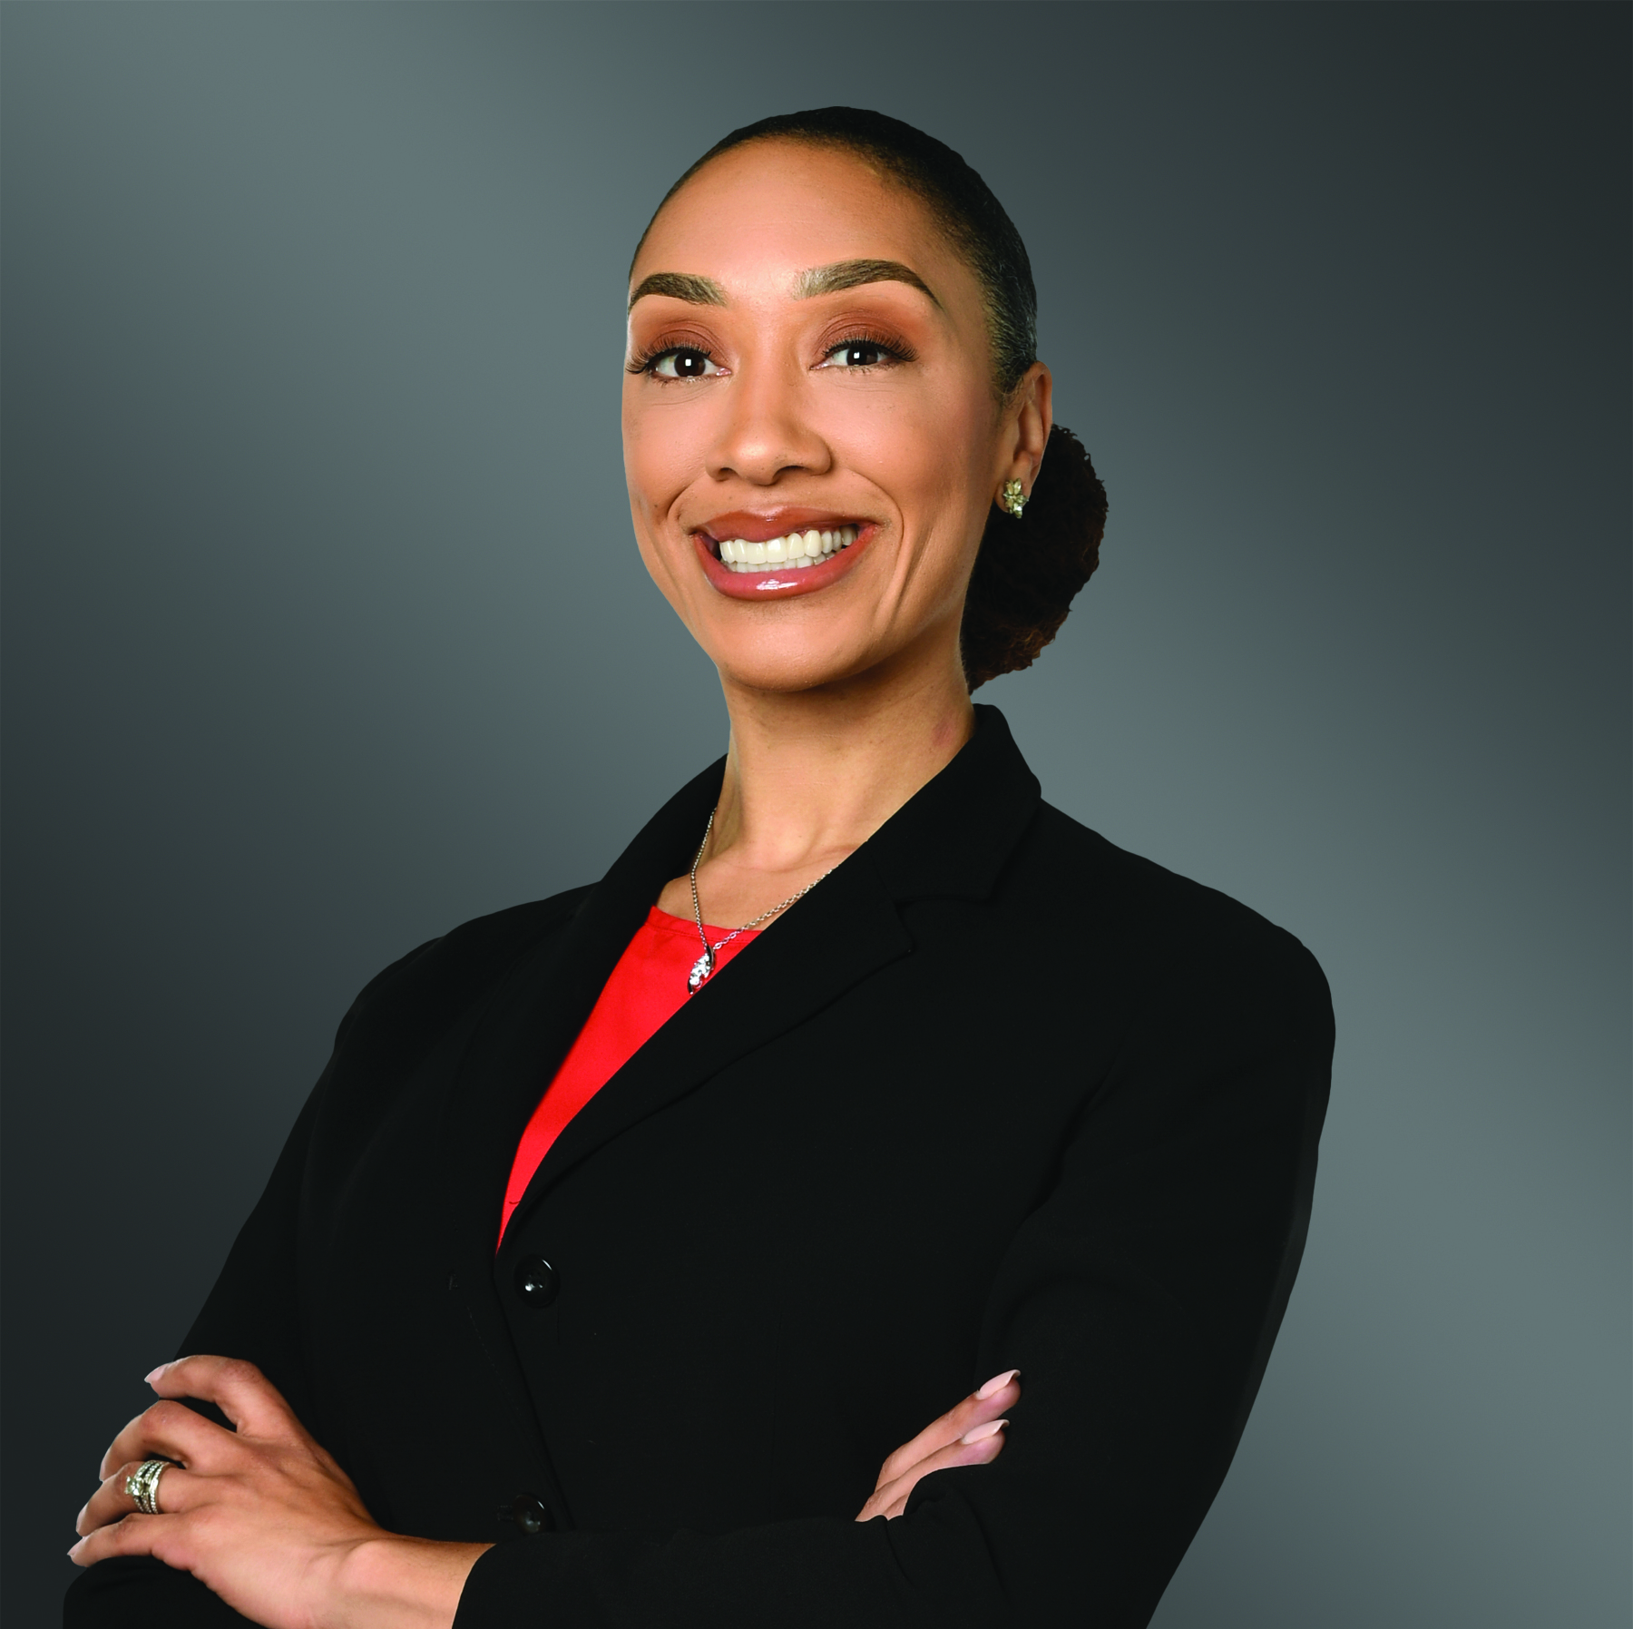
THANK YOU
Toni N. Brown
O: 678.553.2122
toni.brown@gtlaw.com

